Slide 1
Welcome
Interface Meeting
Between Municipal Health Office and Pantawid Parent Leaders
eFDS9 – Tapatan sa Kalusugan
Notes:
[GREETINGS, INTRODUCE SELF AS FACILITATOR, WELCOME PARTICIPANTS – SERVICE PROVIDER, PARENT LEADERS, OTHERS PRESENT]

Slide 2
eFDS9 – Tapatan sa Kalusugan
Pantawid Pamilyang Pilipino Program
Project i-Pantawid
BHS Equipment Checklist
Community Scorecard
Scorecard results
Action planning
Notes:
These are the topics we will cover today.

Slide 3




Notes:
Since the audience includes services providers who may not be familiar with the Pantawid Program nor i-Pantawid, a short introduction is included in these slides.

Slide 4































●
Ito ay isang puhunang pantao para sa mga bata sa pamamagitan ng pangangalaga ng kalusugan at edukasyon
●
Nagbibigay ng tulong sa mga mahihirap na pamilya na may mga anak edad 0-18 yrs. old kasama ng kanilang mga ina
●
Putulin ang manang kahirapan sa pamamagitan ng pagpapalago sa pantaong kayamanan, gaya ng edukasyon, kalusugan at nutrisyon
Notes:
[READ AND ENSURE UNDERSTANDING] [CAN ASK A PARENT LEADER TO SHARE THIS SLIDE]

Slide 5




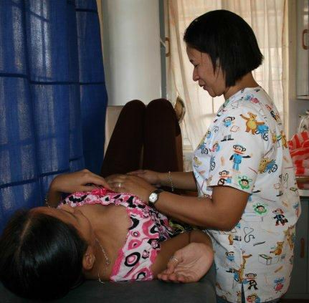










Mga Kondisyon upang makamit ang BENEPISYO
Pumunta sa lokal na health center para sa check-up bago at pagkatapos manganak
Magkaroon ng kahit isang check-up anim na linggo pagkatapos manganak
Notes:
[READ AND ENSURE UNDERSTANDING] [CAN ASK A PARENT LEADER TO SHARE THIS SLIDE]

Slide 6
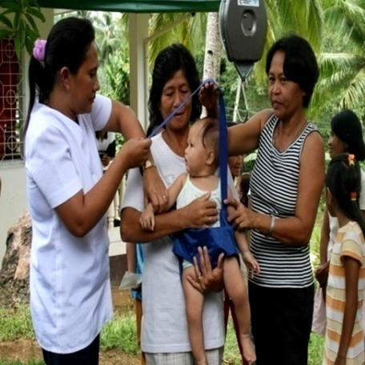
Mga Kondisyon upang makamit ang BENEPISYO
Children 0-5 Years Old
Visit the health center to avail immunization Pagbabakuna
Have monthly weight monitoring and nutrition counseling for children aged 0 - 2 years old Magtimbang minsan kada buwan
Have bi-monthly weight monitoring for 2 – 5 months old Magtimbang minsan kada 2 buwan
Have management of childhood diseases for sick children Mabigyang lunas ang batang may sakit
Children 6-18 Years Old
Must receive deworming pills twice a year (through school) Magpurga sa paaralan
Notes:
[READ AND ENSURE UNDERSTANDING] [CAN ASK A PARENT LEADER TO SHARE THIS SLIDE]

Slide 7

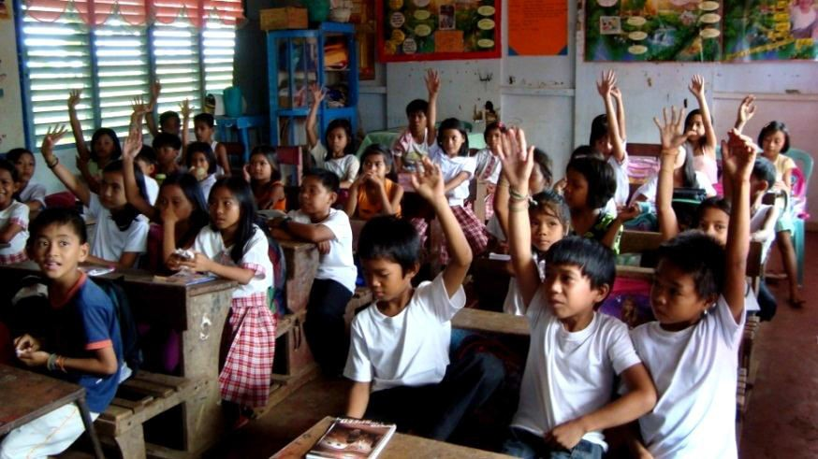



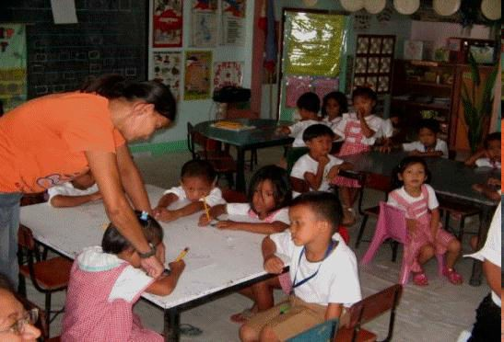

Mga Kondisyon upang makamit ang BENEPISYO
Pumapasok sa Day Care o pre-school at may attendance na di bababa sa 85% kada buwan
Pumapasok sa elementarya o high school at may attendance na di bababa sa 85% kada buwan
Notes:
[READ AND ENSURE UNDERSTANDING] [CAN ASK A PARENT LEADER TO SHARE THIS SLIDE]

Slide 8

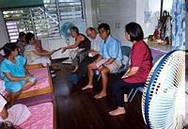



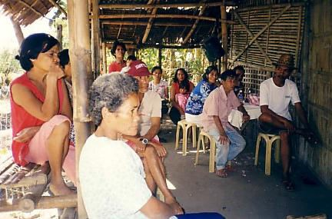



Mga Kondisyon upang makamit ang BENEPISYO
Dumalo sa FDS minsan sa isang buwan
Lumahok sa mga gawaing barangay at palakasin ang pagpapatupad ng Pantawid na programa
Notes:
[READ AND ENSURE UNDERSTANDING] [CAN ASK A PARENT LEADER TO SHARE THIS SLIDE]

Slide 9
i-PANTAWID Objective
To develop a model
for civil society – government partnership
for transparent and accountable
implementation of the
Pantawid Pamilyang Pilipino Program (4Ps)
From the grant agreement – “Capacity building of member organizations of the NLCGG through, inter alia, the carrying out of workshops and training for partner CSOs of the NLCGG to facilitate the adoption of common TPM procedures and tools developed under Part 1, common FDS training curriculum developed under Part 2, and a common menu of social accountability tools for use in the project.”
Notes:
This activity is part of Project i-Pantawid, funded by the Global Partnership for Social Accountability or GPSA, a part of the World Bank. The project proponents are CCAGG, based in Abra, RECITE, based in Pangasinan, and 2 international organizations, PTF and ANSA EAP. You can see their logos at the bottom of this slide. I represent a local civil society organization, [NAME], that is implementing Project i-Pantawid in this LGU. We are a member of the Northern Luzon Coalition for Good Governance or NLCGG.

Slide 10
LGU Selection
Presence of NLCGG partner CSO
Letter of support/MOA from the Mayor
  Provide venue for PL training
  Willing to enter into a Social Contract with Pantawid members
Approved LCSO proposal
Notes:
You may be wondering how your LGU was selected for this project.
The first requirement is that there is a local CSO who would be willing to implement in the LGU. This is our organization, [LCSO NAME].
We then approached your mayor who welcomed the project and entered into a MOA with us [LCSO NAME]. Your mayor provided the venue for the PL training and is willing to enter into a Social Contract with the Pantawid members.
Our organization then prepared a project proposal and budget that was approved by the project management.

Slide 11
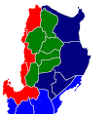
i-Pantawid LGUs
Northern Luzon
(Regions I, II, CAR)
Solsona, Ilocos Norte
San Nicolas, Ilocos Norte
Badoc, Ilocos Norte
Tineg, Abra
Batch 1 – 5 LGUs
Batch 2 – 7 LGUs
Batch 3 – 8 LGUs
Total – 20 LGUs
Pilar, Abra
Pidigan, Abra
Rizal, Kalinga
Tayum, Abra
Candon City, Ilocos Sur
Sta Maria, Ilocos Sur
Burgos, Isabela
Sudipen, La Union
Lamut, Ifugao
San Juan, La Union
La Trinidad, Benguet
Balungao, Pangasinan
Asingan, Pangasinan
Rosales, Pangasinan
Mapandan, Pangasinan
Urdaneta City
Notes:
Project i-Pantawid has been implemented in 20 LGUs in Northern Luzon. Based on this good experience, other LGUs may also adopt this model.

Slide 12
What is the enhanced Family Development Session (eFDS)?
LCSO trains Parent Leaders who will train their own beneficiary groups
  Topics on the construction of citizenship and social accountability – common curriculum
  4 hours for Parent Leaders who will conduct regular 2 hours for their beneficiary groups
  Parent Leaders trained by ML group of around 25 PLs, beneficiary groups have 25 – 35 members
Parent Leaders trained in a central location, beneficiary groups trained within the barangay
Mandatory attendance by Grantee, representing the beneficiary family
PL practice social accountability through implementation of monitoring tools
Notes:
Under the Pantawid Program of the government, beneficiaries attend a monthly training activity in groups in the barangay. Under Project i-Pantawid, we implemented the enhanced Family Development Session or eFDS. Under the eFDS, [READ and ENSURE UNDERSTANDING].

Slide 13
Multiplier Effect
i-Pantawid Implementing CSO
Parent Leader
Beneficiary Group
Parent Leader
Beneficiary Group
Parent Leader
Parent Leader
Beneficiary Group
Beneficiary Group
100% eFDS conducted monthly for covered LGUs
Notes:
Under the eFDS, our LCSO trains the Parent Leaders on self development and the eFDS topic to be shared with their members, monthly. After this training, the PLs cascade the eFDS topic to their member. Our LCSO works to ensure 100% eFDS conducted monthly for covered LGUs.

Slide 14
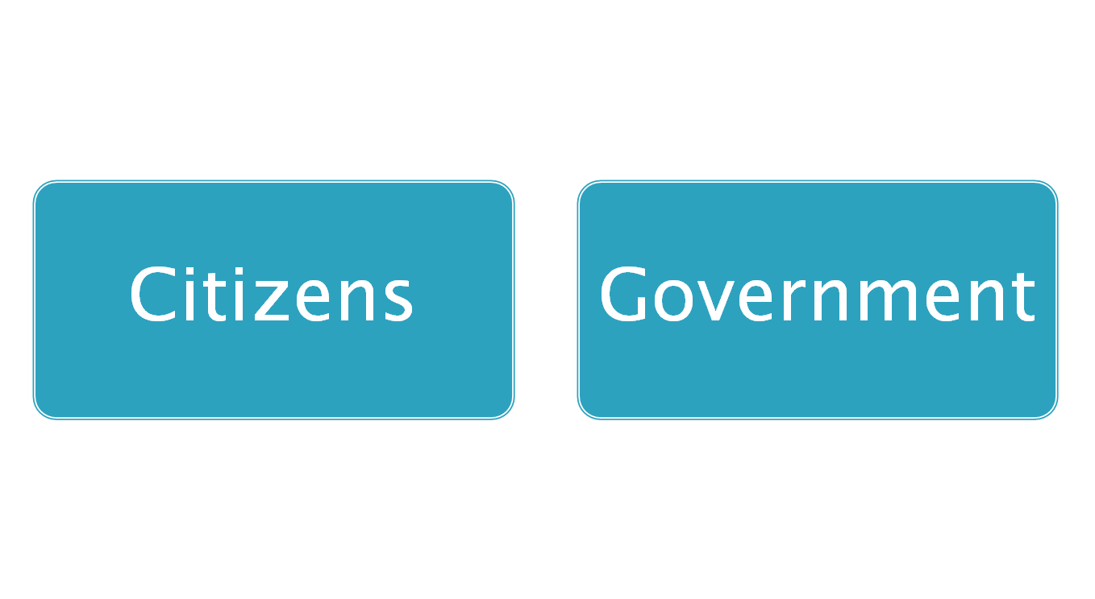
2 Key Players
Constructive Engagement (Makabuluhang Pakikilahok)
For better delivery of
Public service
Improvement of people’s welfare
Protection of people’s rights
= Social Accountability
(Pananagutang Panlipunan)
Notes:
The eFDS modules focus on Social Accountability or Pananagutang Panlipunan.
There are 2 key players that have to work together (pagtutulungan) towards good governance – citizens and government working hand-in-hand. This working together is called constructive engagement (makabulunhang pakikilahok).
The goal of constructive engagement is better delivery of public service, improvement of people’s welfare and protection of people’s rights.
When citizens and government are truly working together, with real citizen participation, they are practising social accountability (pananagutang panlipunan).
14

Slide 15
Ang Aming BHS
Mangaldan, Pangasinan
Aug 2013
Sample format, replace with local data
> 4 OUT OF THE 32 SPHYGMOMANOMETERS ARE DEFECTIVE (INLAMBO, BUENLAG, MACAYUG, DAVID)
> 2 OUT OF THE 27 WEIGHING SCALE FOR ADULTS ARE DEFECTIVE (INLAMBO, GUGUILONEN)
> 3 OUT OF THE 11 WEIGHING SACLE FOR INFANTS ARE DEFECTIVE (BANAOANG, OSIEM, DAVID)
> 9 BHS USE TAPE MEASURE
Source: Data gathered by Pantawid Parent Leaders in the Barangay
Notes:
Last month, the Parent Leaders conducted a review of BHS equipment. This is the summary by barangay. [DISCUSS AND SUMMARIZE AREAS FOR IMPROVEMENT NEEDED (MISSING AND DEFECTIVE EQUIPMENT), NOTE ANY COMMENTS/COMMITMENTS BY SERVICE PROVIDER]

Slide 16
Community Scorecard (CSC)
A participatory, community-based monitoring and evaluation tool Pamamaraan para makilahok sa pamamahala at pagsusuri
That enables citizens to assess the quality of public services such as a health center, school, public transport, water, waste disposal systems, etc., seeking areas for improvement Pagsusuri ng kalidad ng serbisyo publiko kagaya ng para sa kalusugan, edukasyon, transportasyon, patubig, atbp. para mapabuti o mapaganda ito
Notes:
[READ & ENSURE UNDERSTANDING]

Slide 17
Proseso ng Community Scorecard (CSC)
The CSC informs community members about Paguusapan ang
  available services in the community serbisyo publiko
  their entitlements to these services karapatan natin ukol sa serbisyo publiko
The CSC asks for users’ direct feedback about the quality, efficiency, and accessibility of these services Nagtatanong tungkol sa kalidad, husay at pagkarating ng serbisyo publiko, sa pagbibigay ng “score”
Notes:
[READ & ENSURE UNDERSTANDING]

Slide 18
Proseso ng Community Scorecard (CSC)
Those providing the public service also rate their performance Ang tagapamahala sa serbisyo publiko ay nagbibigay alam din tungkol sa kalidad, husay at pagkarating ng kanilang serbisyo publiko
The service providers and their clients sit down and discuss the scorecard results and how to improve these Ang tagapamahala sa serbisyo publiko at ang tumatanggap ng serbisyo ay nakikipa-ugnayan tungkol sa resulta at paano mapaganda pa ang serbisyo publiko
---Interface Meeting---
Notes:
[READ & ENSURE UNDERSTANDING]
At our meeting today, we will discuss the scorecard results and how to improve these, called an Interface Meeting.

Slide 19
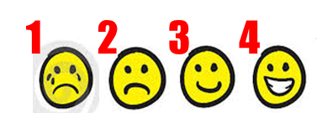
Health Services Community Scorecard
We reviewed the health services provided by our LGU on specific attributes Sinuri natin ang tungkol sa serbisyo kalusugan ng ating bayan
For each attribute, we assigned a score Nagbibigay tugon sa bawat katangian
Indicated reasons for the rating Naglagay ng detalya kung bakit ganun ang ibinigay na puntos at mga mungkahi para mapabuti ang puntos
Ginawa ito para sa Rural Health Unit (RHU) at Barangay Health Station (BHS)
Notes:
This is what we have done so far. [READ & ENSURE UNDERSTANDING]

Slide 20
Notes:
We distributed the scorecard for the RHU and BHS to the service providers and to the Parent Leaders. The service providers fills up individual forms while the Parent Leaders solicited scores from their members. We have computed for the average score per indicator.

Slide 21
Notes:
This is the BHS scorecard we distributed earlier.

Slide 22
Proseso ng Community Scorecard (CSC)
Supply Side Information
RHU/BHS Scorecard
Pasya ng Mamamayan
Pasya ng Tagapamahala ng Serbisyo Publico
Interface Meeting/Ugnayan
Action Planning/Pagplano sa Pagbuti ng Serbisyo
Notes:
This is the process we are following. We took supply-side information and made a scorecard. Both citizens and health service providers gave their scores. Today, we are meeting to discuss the scores and to make plans to improve the scores going forward, together.

Slide 23
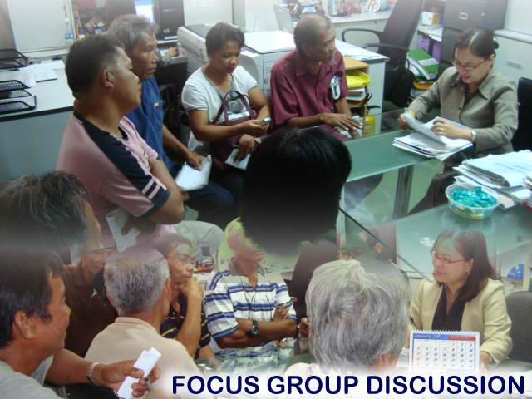
Interface Meeting/Ugnayan
A public forum or meeting where the service providers and users gather to present their respective scorecards and discuss ways to improve service delivery Pagtitipon ng mamamayan at tagapamahala sa serbisyo publiko upang pag-usapan ang mga nabigyang puntos at paano mapabuti ito.
Notes:
We are having an Interface Meeting, where the service providers (MHO staff) and users of the service (tayong mamamayan) gather to present their respective scorecards and discuss ways to improve service delivery.

Slide 24
Layunin ng Interface Meeting
To provide a feedback mechanism between the community end-users and government service providers on the quality, efficiency and accountability of the services provided Ugnayan tungkol sa husay ng serbisyo publiko
To agree on recommended solutions, and come up with a plan that will help improve the delivery of services at the local level Magkaisa kung paano mapaganda pa ang serbisyo publiko
Notes:
Magkakaroon ng ugnayan at tapatan tungkol sa husay ng serbisyo pagkalusugan sa pagtitipon na ito. Magkakaisa at magtutulungan kung paano mapaganda pa ang serbisyo pangkalusugan.

Slide 25
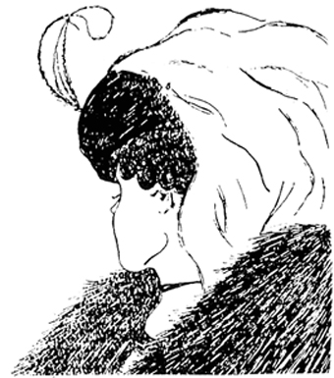
Notes:
Anong nakikita sa litratong ito? Ang iba makakita ng dalaga. Ang iba makakita ng matanda. Sino ang nakakakita ng dalawa? In one picture, we can see different things due to different viewpoints. Pwedeng magkaibang kuru-kuro sa isang bagay. Tingnan natin ang magkaibang kuru-kuro natin tungkol sa serbisyo publiko ng kalusugan.

Slide 26

Mangaldan, Pangasinan
Rural Health Unit
July 2013
Respondents – Pantawid Benificiaries
Health Services Delivery Scorecard
1
2
3
4
Sample format, replace with local data
Notes:
[2 sets of slides will be prepared, one for RHU and another for the BHS. Samples are given here for both. This slide starts the RHU deck. Chart formatting is best using excel.
This chart contains the average score per indicator gathered from the beneficiaries, sorted from highest to lowest score. The green line is drawn in, highlighting indicator scores 3.0 and above.
Present the scores from highest to lowest. Affirm the service provider for the higher scores. The lower scores are opportunities for improvement. We have to be careful in the presentation throughout. We don’t wish the service provider to become defensive but to remain open to the opportunities for improvement.]

Slide 27
Mangaldan, Pangasinan
Rural Health Unit
July 2013
Health Services Delivery Scorecard
1
2
3
4
Sample format, replace with local data
Notes:
This chart contains the average score per indicator gathered from both the service provider and Pantawid beneficiaries, sorted from highest to lowest score of the beneficiaries. The green line is drawn in, highlighting indicator scores from the beneficiaries of 3.0 and above.
Point out indicators with similar scores from both the beneficiaries and service provider, then go through indicators with very different scores. Affirm the service provider for the higher scores. The lower scores are opportunities for improvement. We have to be careful in the presentation throughout. We don’t wish the service provider to become defensive but to remain open to the opportunities for improvement.]

Slide 28
Suggestions for Improvement - RHU
Sample format, replace with local data
Availability of immunization
  Announce immunization schedule
  Mahaba ang pila
  Kung minsan walang gamot
Laboratory
  Kulang ng gamit
  Maliit ang lugar
Sa BHS magpabakuna, hindi sa RHU
Sana magkaroon ng x-ray, FBS, ECG
Notes:
[The following charts contain the reasons for rating (black) and suggestions for improvement (red) from the beneficiaries, for each indicator. The scores for the indicators in the slide are given as a reference during the discussion. For satisfactory scores, the suggestion for improvement could simply be to maintain the current state. There may be 2 to 3 indicators per slide. The objective of the slide content is to trigger a discussion between the beneficiaries and service provider. The objective of the discussion is to arrive at specific action plans towards service improvement.
For each indicator, share the beneficiary score, then move to the reasons for rating and suggestions for improvement given. Solicit other suggestions for improvement per indicator. Any agreed action steps are to be written on a manila paper that everyone can view, following the Action Plan template in this deck.
When there are time constraints, the facilitator may opt to start the discussion from the indicators with the lowest beneficiary score, moving up towards the higher scores.

Slide 29
Suggestions for Improvement - RHU
Sample format, replace with local data
Availability of doctor
  Minsan wala si doctora
Laboratory test
  Hindi lahat ng test libre
  Natatagalan ang resulta
Sana dagdagan ang doctor
Sana lahat ng test libre
Notes:
For each indicator, share the beneficiary score, then move to the reasons for rating and suggestions for improvement given. Solicit other suggestions for improvement per indicator. Any agreed action steps are to be written on a manila paper that everyone can view, following the Action Plan template in this deck.

Slide 30
Suggestions for Improvement - RHU
Sample format, replace with local data
Availability of nurse
  Minsan suplada, masungit
  May favoritism
Waiting area
  Mainit
  Kulang sa upuan, siksikan
Client service orientation
Linawin ang pila/priority system
Dagdagan ng electric fan
Check-up sa BHS
Notes:
For each indicator, share the beneficiary score, then move to the reasons for rating and suggestions for improvement given. Solicit other suggestions for improvement per indicator. Any agreed action steps are to be written on a manila paper that everyone can view, following the Action Plan template in this deck.

Slide 31
Suggestions for Improvement - RHU
Sample format, replace with local data
Comfort room
  Sana hiwalay ang babae at lalake
  Mabaho, madumi at minsan walang tubig
  Walang lock sa pintuan
  Walang tabo at timba
Staff behavior
  Nakasimangot pag may tanong, suplada
  May palakasan
  Nakikipagkwentuhan
Need to improve facilities
Client service orientation
Sundin ang pila
Smile ☺
Notes:
For each indicator, share the beneficiary score, then move to the reasons for rating and suggestions for improvement given. Solicit other suggestions for improvement per indicator. Any agreed action steps are to be written on a manila paper that everyone can view, following the Action Plan template in this deck.

Slide 32
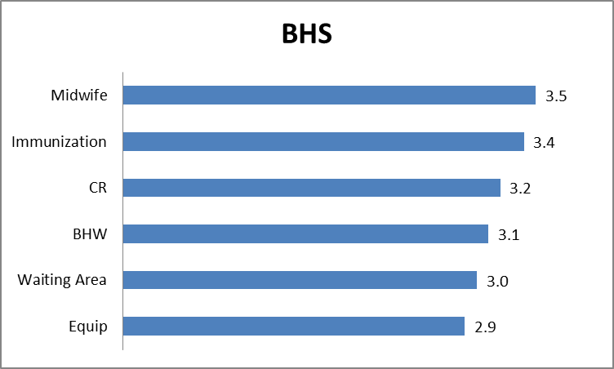
Mangaldan, Pangasinan
Barangay Health Stations
July 2013
Respondents – Pantawid Benificiaries
Health Services Delivery Scorecard
1
2
3
4
Sample format, replace with local data
Notes:
This slide starts the BHS deck. This chart contains the average score per indicator gathered from the beneficiaries, sorted from highest to lowest score. The green line is drawn in, highlighting indicator scores 3.0 and above.
Present the scores from highest to lowest. Affirm the service provider for the higher scores. The lower scores are opportunities for improvement. We have to be careful in the presentation throughout. We don’t wish the service provider to become defensive but to remain open to the opportunities for improvement.]

Slide 33
Mangaldan, Pangasinan
Barangay Health Stations
July 2013
Health Services Delivery Scorecard
1
2
3
4
Sample format, replace with local data
Notes:
This chart contains the average score per indicator gathered from both the service provider and Pantawid beneficiaries, sorted from highest to lowest score of the beneficiaries. The green line is drawn in, highlighting indicator scores from the beneficiaries of 3.0 and above.
Point out indicators with similar scores from both the beneficiaries and service provider, then go through indicators with very different scores. Affirm the service provider for the higher scores. The lower scores are opportunities for improvement. We have to be careful in the presentation throughout. We don’t wish the service provider to become defensive but to remain open to the opportunities for improvement.]

Slide 34
Suggestions for Improvement - BHS
Availability of midwife
  Sana araw-araw may midwife
  Huwag hingan ng donation ang parents
Immunization
  Sana may ibang gamot pa
Comfort room
  Some BHS no CR or no water
Sample format, replace with local data
Need to improve facilities for some BHS
Notes:
[The following charts contain the reasons for rating (black) and suggestions for improvement (red) from the beneficiaries, for each indicator. The scores for the indicators in the slide are given as a reference during the discussion. For satisfactory scores, the suggestion for improvement could simply be to maintain the current state. There may be 2 to 3 indicators per slide. The objective of the slide content is to trigger a discussion between the beneficiaries and service provider. The objective of the discussion is to arrive at specific action plans towards service improvement.
For each indicator, share the beneficiary score, then move to the reasons for rating and suggestions for improvement given. Solicit other suggestions for improvement per indicator. Any agreed action steps are to be written on a manila paper that everyone can view, following the Action Plan template in this deck.
When there are time constraints, the facilitator may opt to start the discussion from the indicators with the lowest beneficiary score, moving up towards the higher scores.

Slide 35
Suggestions for Improvement - BHS
Sample format, replace with local data
BHW behavior/attitude
  May BHW na masungit, nagrereklamo
Waiting area
  Some BHS kulang sa upuan, electric fan
Equipment
  Kulang sa gamit
  Kulang sa gamot
Baguhin ang ugali
Need to improve facilities for some BHS
Equipment check
Notes:
For each indicator, share the beneficiary score, then move to the reasons for rating and suggestions for improvement given. Solicit other suggestions for improvement per indicator. Any agreed action steps are to be written on a manila paper that everyone can view, following the Action Plan template in this deck.

Slide 36
INTERFACE MEETING ACTION PLAN – RHU LGU_____________________________ Date ________________
No | Indicator | Action to be Taken | By Whom | When
1 | Availability of Doctor | Hire contractual doctor Tap interns/clerks | MHO/LGU MHO/ R1MC-LNU | 2014 Dec 2013
2 | Availability of Nurse | Wireless Access on Health | MHO | 2014
3 | Staff Behavior/ Attitude | Discuss orientation on client service Need to bring Family No. to RHU Bawal nakasimangot! ☺ | Recite/MHO Beneficiaries MHO/RHU Staff | Nov 2013 When going to RHU ASAP
4 | Availability of Immunization | All immunizations to be taken at BHS Update form for change of facility if needed Remove donation box Tarpaulin announcement “Free immunization” | PL/ Beneficiaries ML/PL/ Beneficiaries MHO/ Midwife MHO/ Midwife | ASAP Nov – Dec 2013 ASAP Jan 2014
Sample format, replace with local data
Notes:
[This is the Action Plan Template. During the Interface Meeting, the action plans contributed and agreed upon by the group are written on manila paper for all to see. After the Interface Meeting, transfer the action plans from manila paper to this template for documentation purposes. There will be two Action Plans prepared, one each for the RHU and BHS. Action Plans may need more than one slide.]

Slide 37
INTERFACE MEETING ACTION PLAN – BHS LGU_____________________________ Date ________________
No | Indicator | Action to be Taken | By Whom | When
1 | Availability of Midwife | BHW on duty in the absence of midwife Orientation for beneficiaries on service of BHW & Community Health Team (CHT) Interface meeting in barangay with Punong Barangay, Committee on Health, BSPO Post midwife schedule/locator board in BHS | MHO/ Barangay Recite/PL/ MHO/ Brgy Officials Recite/PL/ MHO/ Brgy Officials MHO/ Midwife | Nov 2013 Jan 2014 Jan 2014 Nov 2013
2 | Staff Behavior/ Attitude | Bawal nakasimangot! ☺ | MHO/ Midwife | Oct 2013
3 | Availability of Equipment | For height measurement, can use tape measure on bamboo stick | MHO/ Midwife | Nov 2013
Sample format, replace with local data

Slide 38
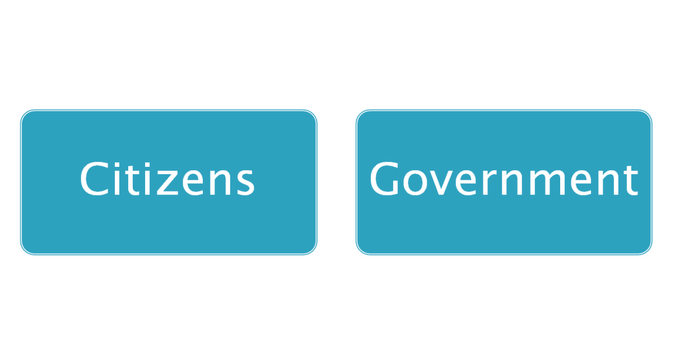

Coming together is a beginning,
staying together is progress, and
working together is success.
-- Henry Ford
Ang pagsasama-sama ay pang-umpisa,
Ang manatiling magkasama ay progreso,
Ang magkasamang magtrabaho ay tagumpay.
Notes:
Ang pagsasama-sama ay pang-umpisa, ang manatiling magkasama ay progreso, ang magkasamang magtrabaho ay tagumpay.
Manatili tayong magkasama, mamamayan at tagapamahala ng serbisyo publiko, para makamtan ang tagumpay!

Slide 39
Maraming salamat po!

