Slide 1
Welcome
TUNGO SA
BAYANG MAGILIW - 7
Ang Kaban ng Bayan
Notes:
[GREETING, INTRODUCE SELF AS FACILITATOR]

Slide 2
eFDS7 – Ang Kaban ng Bayan
Review of Social Accountability
Review of Pangarap ng Pamayanan
The National Budget and IRA
Review of the Public Financial Management Cycle
The Barangay Budget and Legal Basis
How to read and review the Barangay budget
Workshop Outcome
Sample monitoring of the barangay budget
Notes:
This is what we will cover in today’s training.

Slide 3
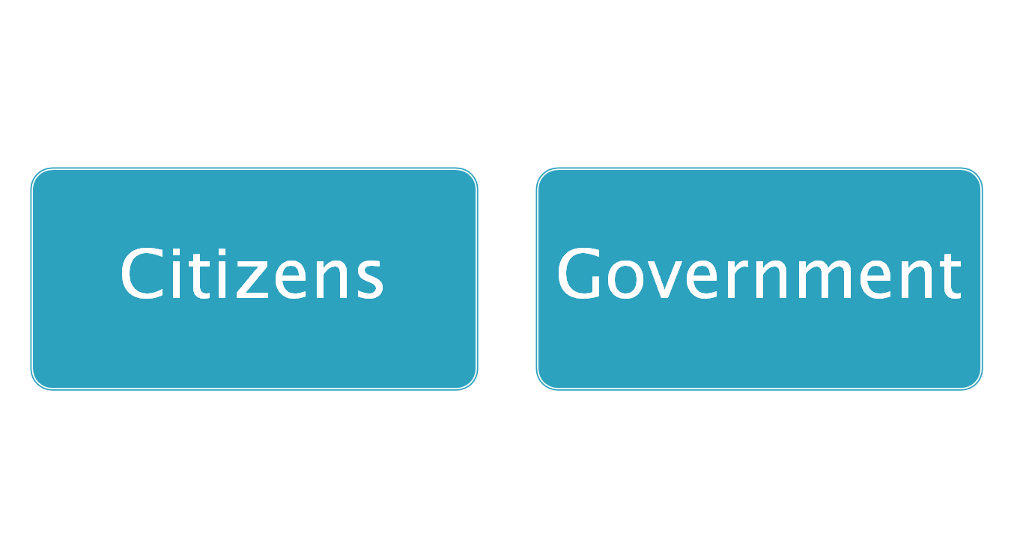
2 Key Players
Constructive Engagement (Makabuluhang Pakikilahok)
For better delivery of
Public service
Improvement of people’s welfare
Protection of people’s rights
= Social Accountability
(Pananagutang Panlipunan)
Notes:
Review slide - there are 2 key players that have to work together (pagtutulungan) towards good governance – citizens and government working hand-in-hand. This working together is called constructive engagement (makabulunhang pakikilahok).
The goal of constructive engagement is better delivery of public service, improvement of people’s welfare and protection of people’s rights.
When citizens and government are truly working together, with real citizen participation, they are practising social accountability (pananagutang panlipunan).
3

Slide 4
Ang Pangarap na Pamayanan
LGU ___________________________ as of (month/year)
Mapayapa at napapatupad ang batas
Nagmamahalan at nagtutulungang mamamayan
Maunlad
(EXAMPLE ONLY – REPLACE WITH OWN APPROPRIATE DATA FROM eFDS 2)
Maka-Diyos
Malinis at ligtas na kapaligiran
Nakikilahok at nagkakaisa na mamamayan
Notes:
Let’s remind ourselves of what we would like to see in our community. This vision should guide us in all our efforts.

Slide 5
Budget by Department and Special Purpose Fund 2014
(EXAMPLE ONLY – UPDATE WITH DATA FROM www.dbm.gov.ph)
Ang Kaban ng Bayan
Total 2014 – P2.268 Trillion
Source: Dept of Budget and Management www.dbm.gov.ph
Notes:
Replace data with appropriate year from www.dbm.gov.ph. Read total, other relevant budget items.

Slide 6
IRA
2014
Barangay Funds
Lahat ng kita ay pumapasok sa General Fund
Iniingatan ng city/municipal treasurer o naka-deposito sa malapit na banko ng gobyerno
+13% vs 2013
Mangaldan LGU –
P128,432,880
Pangasinan Provincial Government –
P2,133,510,832
Pangasinan All City/Mun –
P7,195,234,424
Pangasinan All Brgy –
P2,097,558,609
Total Pangasinan (Prov/City/Mun/ Brgy)
P11.4B
(EXAMPLE ONLY – UPDATE WITH DATA FROM www.dbm.gov.ph)
Allocation --
55% Personnel maximum
20% Local Development Fund (LDF)
10% SK
+
5% GAD Fund (can be part of LDF)
1% of IRA - Protection of children
5% Disaster (70:30)
2% of RPT - discretionary fund of PB
Senior citizens
Environment
Source: Dept of Budget and Management www.dbm.gov.ph
Notes:
Replace with appropriate data for the LGU from www.dba.gov.ph.
Each and every barangay has its own IRA. Give examples for the barangays of those present.
The city/municipality has its own IRA, give amount.
The province has its own IRA, give amount. Give total IRA (barangay, all LGUs, province) that went to the province (ex. Pangasinan = P11.4B in 2014).
Discuss barangay funds and mandatory allocations.

Slide 7
Barangay Assembly
Consultations
Barangay Development Council
Financial Reporting
Project Monitoring
Public Service Monitoring
Planning
Budgeting
Expenditure
Monitoring
Pagmamanman
Pagplano
Public
Financial
Management
Cycle
Pananagutang Panlipunan
Para sa mas mahusay na paghahatid ng
- Palingkurang pangmadla
Pagpabuti ng kapakanang mamamayan
Pangangalaga ng karapatan pantao
Pagbadyet
Paggugol
Financial Reporting
Cost of Project
Project Allocation
Budget Hearing
IRA
Notes:
Our Social Accountability can be exercised throughout the Public Financial Management or PFM Cycle.
Public financial management begins with planning on what projects will be most helpful to the community. Citizens can participate in PFM planning through participation in the Barangay Assembly, other consultations, and through membership in the Barangay Development Council.
The next step in the PFM is budgeting. Citizens can participate through reviewing the project allocations, attending the budget hearings, reviewing where the IRA went.
After budgeting is expenditure, when funds are spent. Citizens can review the financial reporting, check on the cost of projects.
After expenditure is monitoring. Citizens can participate in project monitoring and review of financial reporting. After monitoring, we go back to planning. This is a yearly cycle.
Would you like to help government with their public financial management? Would you like to learn more about this? We will be teaching you how to budget and how to read financial reports. Would you like that?

Slide 8
Barangay Budget Process
Schedule | Barangay Treasurer | Punong Barangay | Sangguniang Barangay | Sangguniang Bayan | Citizens
Planning
Jul - Aug
Convenes Barangay Development Council (BDC), prepares Barangay Development Plan (BDP)
2 – 3 members of BDC
Budget Preparation
Sept – Oct 15
Estimate of income and expenditure
Prepares budget
Submits budget to Sangguniang Barangay
Evaluates budget and passes Appropriation Ordinance
Budget Authorization
Oct 16 – Nov 15
Submits Appropriation Ordinance to Mun. Budget Officer
Budget Review
Nov 16 – Dec 31
Reviews budget for compliance
Receives approved budget
Budget Execution
Jan 1 – Dec 31
Disburses cash per LGC
Monitors finances, projects and performance of officials
Submits financial report
Reviews/signs financial report, post in 3 public places
Budget Accountability
Jan 1 – Dec 31
Source: Local Government Code of 1991
Notes:
This is public financial management in the barangay and this happens yearly, beginning in July/August for the next year. For example, in July/August of 2015, the Punong Barangay should convene the Brgy Development Council (BDC) to prepare the Brgy Development Plan (BDP) for 2016. The BDC should include 2 – 3 members of the community.
In September, the Brgy Treasurer submits to the Punong Barangay the estimate of income and expenditure for the next year and the Punong Barangay allocates the income based on the BDP. By Oct. 16, the budget is presented to the Sangguniang Barangay for review and agreement. The Sangguniang Barangay then passes an Appropriation Ordinance.
By Nov. 16, the Appropriation Ordinance is submitted to the Municipal Budget Officer who reviews the allocations for compliance to laws and presents this to the Sangguniang Bayan for ratification.
The budget goes into effect on Jan 1 of the following year. The Barangay Treasurer can now spend funds based on the approved Appropriation Ordinance and submits a monthly financial report. By Jan. 30, an annual financial report is prepared covering the entire year. The Punong Barangay reviews and signs the financial report which should now be posted in 3 conspicuous, public places.
Citizens can review the financial reports also, monitor projects and the performance of offficials.
[CHECK FOR UNDERSTANDING, REPEAT IF NOT CLEAR]

Slide 9
Barangay Budget
Fiscal Administration
An estimate of income and expenditure for the succeeding year is submitted by the barangay treasurer to the punong barangay on or before September 15
Punong barangay prepares budget and submits to the SB for legislative enactment
Reviewed by city/municipal SB through city/municipal budget officer within 60 days
Effective January 1 of succeeding year
All taxes, fees, charges are collected by barangay treasurer
Official receipts issued
Deposited within 5 days
Financial records kept in the office of the city/municipal accountant
Funds may only be used for the specific purpose listed in the budget
No advance payments allowed
Summary of income and expenditures of previous year posted in at least 3 publicly accessible and conspicuous places by January 31
Source: LGC Section 352
Source: Local Government Code of 1991
Notes:
[READ & DISCUSS FOR UNDERSTANDING]

Slide 10
Local Government Code
SECTION 352. Posting of the Summary of Income and Expenditures. - Local treasurers, accountants, budget officers and other accountable officers shall, within thirty (30) days from the end of each fiscal year, post in at least three (3) publicly accessible and conspicuous places in the local government unit a summary of all revenues collected and funds received including the appropriations and disbursements of such funds during the preceding fiscal year.
SECTION 353. The Official Fiscal Year. - The official fiscal year of local government units shall be the period beginning with the first day of January and ending with the thirty-first day of December of the same year.
Notes:
These are the appropriate sections of the LGC with regards to posting of the summary of income and expenditures. [READ & DISCUSS]

Slide 11
Barangay Basic Services
(i) Agricultural support services which include planting materials distribution system and operation of farm produce collection and buying stations;
(ii) Health and social welfare services which include maintenance of Barangay health center and day-care center;
(iii) Services and facilities related to general hygiene and sanitation, beautification, and solid waste collection;
(iv) Maintenance of Katarungang Pambarangay;
(v) Maintenance of Barangay roads and bridges and water supply systems
(vi) Infrastructure facilities such as multi-purpose hall, multipurpose pavement, plaza, sports center, and other similar facilities;
(vii) Information and reading center; and
(viii) Satellite or public market, where viable
Source: Local Government Code of 1991, Section 17
Notes:
This is the list of Barangay basic services that the budget should provide for. [READ & DISCUSS]

Slide 12
Budget Document
Budget Message of Punong Barangay
Mga plano at proyekto para sa mas mahusay na paghahatid ng Palingkurang Pangmadla – Barangay Basic Services
Financial Statements
The actual income and expenditures during the immediately preceding year
The actual income and expenditures of the first two (2) quarters and the estimates of income and expenditures for the last two (2) quarters of the current fiscal year
The estimated income and expenditures for the next year
Notes:
These are the contents of the budget document prepared by the Punong Barangay for submission to the Sangguniang Barangay. [READ & DISCUSS FOR UNDERSTANDING]

Slide 13
Barangay Sources of Income
LGU: Barangay: Budget Year:
Source of Income | Amount | %
IRA
Real property tax – 25% to the barangay where the property is located
Business taxes
Quarry (sand, gravel) – 40% of proceeds collected by province
50% of community tax collected through barangay treasurer
Grants and donations
Subsidy from province
Subsidy from municipality
Barangay Certification/ Clearance Fees
Others (specify)
TOTAL --
Notes:
Review the contents of this template. Review the sample barangay financial statement available. Transfer to this form the appropriate amounts from the sample barangay financial statement. Compute percentage over total income.

Slide 14
Barangay Expenditure Program
LGU: Barangay: Budget Year:
PPA Description | Amount | %
Personal Services (max 55% of next preceding year)
B. Maintenance and Other Operating Expenses (MOOE)
C. Special Purpose Allocation
D. Capital Outlay
TOTAL --
Notes:
Review the contents of this template. Review the sample barangay financial statement available. Transfer to this form the appropriate amounts from the sample barangay financial statement. Compute % over total expenditure.

Slide 15
Special Purpose Allocation
LGU: Barangay: Budget Year:
Total Income ____________________ | Amount | %
20% Local Development Fund (LDF)
10% SK
5% GAD Fund (can be part of LDF)
1% of IRA - Protection of children
5% Disaster (70:30)
2% of RPT - discretionary fund of PB
Notes:
These are the mandatory allocations, based on various laws, that have to be provided for in the budget. Review the contents of this template. Review the sample barangay financial statement available. Transfer to this form the appropriate amounts from the sample barangay financial statement. Review whether the amount follows the legal requirement.
Process the experience with participants. Were they able to transfer amounts? Did it become clearer as they discussed? What did they think of the amounts?

Slide 16
5% GAD (Gender and Development)
Notes:
This is the basis of the 5% mandatory allocation for GAD.

Slide 17
1% of IRA for the Protection of Children
Republic Act No. 9344
"Juvenile Justice and Welfare Act of 2006."
SEC. 15. Establishment and Strengthening of Local Councils for the Protection of
Children. - Local Councils for the Protection of Children (LCPC) shall be established in all
levels of local government, and where they have already been established, they shall be
strengthened within one (1) year from the effectivity of this Act. Membership in the LCPC shall be chosen from among the responsible members of the community, including a representative from the youth sector, as well as representatives from government and private agencies concerned with the welfare of children.
The local council shall serve as the primary agency to coordinate with and assist the LGU
concerned for the adoption of a comprehensive plan on delinquency prevention, and to
oversee its proper implementation.
One percent (1%) of the internal revenue allotment of barangays, municipalities and citiesshall be allocated for the strengthening and implementation of the programs of the LCPC: Provided, That the disbursement of the fund shall be made by the LGU concerned.
Notes:
This is the basis for the 1% of IRA mandatory allocation for Children, also called the Children’s fund. Do you remember your barangay IRA? What is 1% of the IRA? That’s the amount that should be used for children in the given year.

Slide 18
5% Local Disaster Risk Reduction and Management Fund (LDRRMF)
Notes:
This is the basis of the 5% mandatory allocation for LDRRM. Of this amount, the LGU may use 70% in preparing for disaster risk reduction and management. The remaining 30% should be set aside for expenditure only during a disaster. Let’s practice. Do you remember your barangay IRA? There may be other sources of income, but let’s pretend the income of your barangay is only from the IRA. What is 5% of your barangay IRA? That is the total allocation for disaster for the year. What is 70% of the disaster fund? That can be spent in preparation, like for flashlights, rubber boats, tents, etc. The remaining 30% can only be spent during a disaster.

