Slide 1
Welcome
TUNGO SA
BAYANG MAGILIW - 5
Ang Kasunduang Panlipunan
Notes:
[GREETING, INTRODUCE SELF AS FACILITATOR]

Slide 2
eFDS5 – Ang Kasunduang Panlipunan
Review of community vision
Review of development priorities
Social Contract content
Social Contract signing event program
Describing the community vision
Selection of PL Representatives who will speak at the Signing Event
Workshop Outcome
Social Contract Draft Document
Notes:
We will be discussing a Social Contract.

Slide 3
Ang Pangarap na Pamayanan
LGU ___________________________ as of (month/year)
Mapayapa at napapatupad ang batas
Nagmamahalan at nagtutulungang mamamayan
Maunlad
(EXAMPLE ONLY – REPLACE WITH OWN APPROPRIATE DATA FROM eFDS 2)
Maka-Diyos
Malinis at ligtas na kapaligiran
Nakikilahok at nagkakaisa na mamamayan
Notes:
This is the vision for our community that we put together in eFDS2. [REVIEW] We should share this vision with our officials so that we can work together on the same focus areas for a better community. We will share this vision through the Social Contract.

Slide 4
ANG PLANO NG AMING PAMAYANAN
LGU/Barangay: Parent Leaders: Date:
PANGARAP | LAYUNIN | SUKAT NG TAGUMPAY | GAWAIN NG MAMAMAYAN | TUGON NG PAMAHALAAN
Nakikilahok at nagkakaisang mamamayan | Magkaroon ng magaling at masipag na pamahalaan | Manalo ang magaling at masipag na candidato | Mamili ng magaling at masipag na punong barangay sa darating na halalan | Masipag na pamamahala
 | Bantayan ang kaban ng bayan | Lahat ng kalahok sa Pantawid ay dumalo sa Barangay Assembly at nagtanong sa proyekto ng brgy | Sumali sa Barangay Assembly at alamin ang pera ng barangay at saan ito ginastos | Tumawag ng Barangay Assembly at handang ihayag ang mga proyekto at budget
(EXAMPLE ONLY – REPLACE WITH OWN APPROPRIATE DATA FROM eFDS 4)
Notes:
We also developed some plans to improve our community in eFDS4. Let’s review what we said.

Slide 5
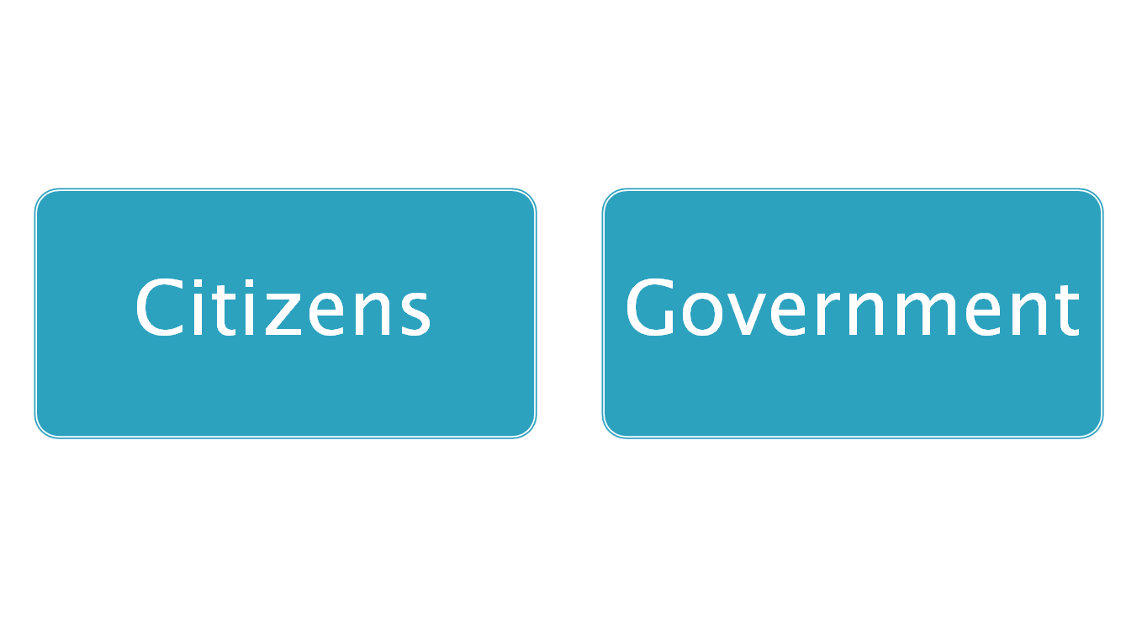
2 Key Players
ANG INAASAHANG TUGON NG LOCAL NA PAMAHALAAN
Constructive Engagement (Makabuluhang Pakikilahok)
Para sa mas mahusay na paghahatid ng
- Palingkurang pangmadla
Pagpabuti ng kapakanang mamamayan
Pangangalaga ng karapatan pantao
Notes:
What we are saying is that as part of our duties to the community, we are willing to help the government do a good job for us. What is this good job we want? Para sa mas mahusay na paghahatid ng - Palingkurang pangmadla, Pagpabuti ng kapakanang mamamayan, Pangangalaga ng karapatan pantao
Working together with government is called “Constructive Engagement”.
[READ & DISCUSS]
If we want the government to work with us, we have to communicate our vision and our suggestions. This can be done through a Social Contract.
5

Slide 6
SOCIAL CONTRACT KASUNDUANG PANLIPUNAN This Social Contract is entered into by duly authorized representatives of the Local Government Unit of _________________________________________________________, (city/municipality, province) represented by officials present, referred to as LGU officials and Pantawid Pamilyang Pilipino Program members of ____________________________________, (city/municipality, province) represented by their Parent Leaders and members present, referred to as Pantawid members.
Document title (Social Contract)
Parties to the Social Contract
Preamble (Batayan ng kasunduan)
Pangarap ng Pamayanan
Ang Plano ng Aming Pamayanan
Tugon ng pamahalaan (LGU officials)
Tugon ng mamamayan (Pantawid members)
Kailan ginawa ang kasunduan
Lagda ng mga kalahok
Notes:
Do we want to share our vision and development suggestions with our LGU officials? We can prepare a Social Contract together and hold an activity where we will invite our LGU officials and ask for their support.
Let’s discuss what our Social Contract will contain. [DISTRIBUTE COPIES OF DRAFT SOCIAL CONTRACT, DISCUSS CONTENT] We will attach copies of your vision (Pangarap ng Pamayanan) and development priorities (Ang Plano ng Aming Pamayanan)
Do we want to have such a Social Contract with the LGU officials? Are you willing to sign such a document?

Slide 7
Social Contract Signing – Program (venue, date, time)
Opening Prayer
Acknowledgment of Participants
A brief introduction of (LCSO) and the i-Pantawid Project
The Social Contract Proper
Social Contract content
Sharing the community vision
Sharing the community development priorities
Response from the Municipal Officials
Signing of the Social Contract
Closing Prayers/Blessing
Picture Taking
Emcee : (name)
Notes:
We will coordinate a signing ceremony with the mayor and other LGU officials for next month. All PLs will attend this single session. This is how the signing event will proceed. [DISCUSS PROGRAM. GET A VOLUNTEER EMCEE FROM AMONG THE PLs]
You will be sharing the community vision and development priorities.

Slide 8
Ang Pangarap na Pamayanan
LGU ___________________________ as of (month/year)
Mapayapa at napapatupad ang batas
Nagmamahalan at nagtutulungang mamamayan
Maunlad
(EXAMPLE ONLY – REPLACE WITH OWN APPROPRIATE DATA FROM eFDS 2)
Maka-Diyos
Malinis at ligtas na kapaligiran
Nakikilahok at nagkakaisa na mamamayan
Notes:
[THE PLs WILL DESCRIBE THE VISION IN THEIR OWN WORDS. FROM ALL PL TRAINING GROUPS, SELECT 6 REPRESENTATIVES WHO WILL EACH DESCRIBE ONE VISION STATEMENT.
Workshop - Divide the participants into 6 groups, each to select a facilitator and a recorder. Provide manila paper and markers. Each working group to create a paragraph expressing one vision statement that will be included in the Kasunduang Panlipunan. The developed paragraphs to be shared in plenary. If there is more than one PL training group, the other PL training groups will start with the vision statements expressed by a prior group, refining the statement.
LCSO to consolidate and refine the 6 vision statements that will be read out during the Social Contract signing event by the selected representatives. Copies of their assigned vision statement to be distributed to the selected 6 representatives before the signing event.]

Slide 9
The vision must be followed by the venture. It is not enough to stare up the steps - we must step up the stairs. ~Vance Havner
Ang pangarap ay dapat sundan ng pagkilos. Hindi sapat na titigan lamang ang hagdanan, kailangan humakbang paakyat.
Tagapagpadaloy ng Pagbabago

