Slide 1
Welcome
Interface Meeting
Between Education Officials and Pantawid Parent Leaders
eFDS11 – Tapatan sa Edukasyon
Notes:
[GREETINGS, INTRODUCE SELF AS FACILITATOR, WELCOME PARTICIPANTS – SERVICE PROVIDER, PARENT LEADERS, OTHERS PRESENT]

Slide 2
eFDS11 – Tapatan sa Edukasyon
Pantawid Pamilyang Pilipino Program
Project i-Pantawid
Community Scorecard
Scorecard results
Action planning
Notes:
These are the topics we will cover today.

Slide 3




Notes:
Since the audience will include education services providers who may not be familiar with the Pantawid Program nor i-Pantawid, a short introduction is included in these slides.

Slide 4







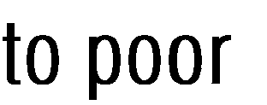















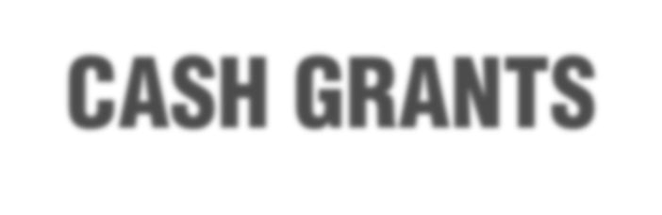







●
Ito ay isang puhunang pantao para sa mga bata sa pamamagitan ng pangangalaga ng kalusugan at edukasyon
●
Nagbibigay ng tulong sa mga mahihirap na pamilya na may mga anak edad 0-18 yrs. old kasama ng kanilang mga ina
●
Putulin ang manang kahirapan sa pamamagitan ng pagpapalago sa pantaong kayamanan, gaya ng edukasyon, kalusugan at nutrisyon
Notes:
[READ AND ENSURE UNDERSTANDING] [CAN ASK A PARENT LEADER TO SHARE THIS SLIDE]

Slide 5




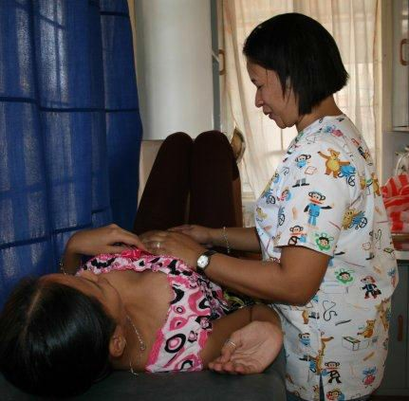










Mga Kondisyon upang makamit ang BENEPISYO
Pumunta sa lokal na health center para sa check-up bago at pagkatapos manganak
Magkaroon ng kahit isang check-up anim na linggo pagkatapos manganak
Notes:
[READ AND ENSURE UNDERSTANDING] [CAN ASK A PARENT LEADER TO SHARE THIS SLIDE]

Slide 6
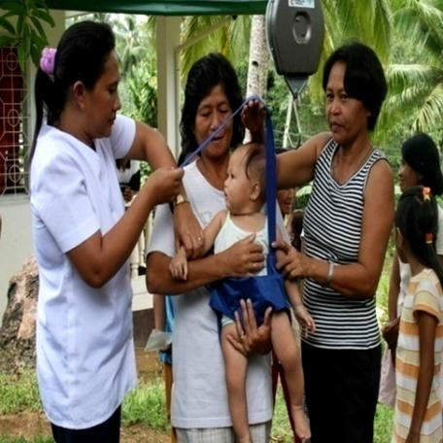
Mga Kondisyon upang makamit ang BENEPISYO
Children 0-5 Years Old
Visit the health center to avail immunization Pagbabakuna
Have monthly weight monitoring and nutrition counseling for children aged 0 - 2 years old Magtimbang minsan kada buwan
Have bi-monthly weight monitoring for 2 – 5 months old Magtimbang minsan kada 2 buwan
Have management of childhood diseases for sick children Mabigyang lunas ang batang may sakit
Children 6-18 Years Old
Must receive deworming pills twice a year (through school) Magpurga sa paaralan
Notes:
[READ AND ENSURE UNDERSTANDING] [CAN ASK A PARENT LEADER TO SHARE THIS SLIDE]

Slide 7

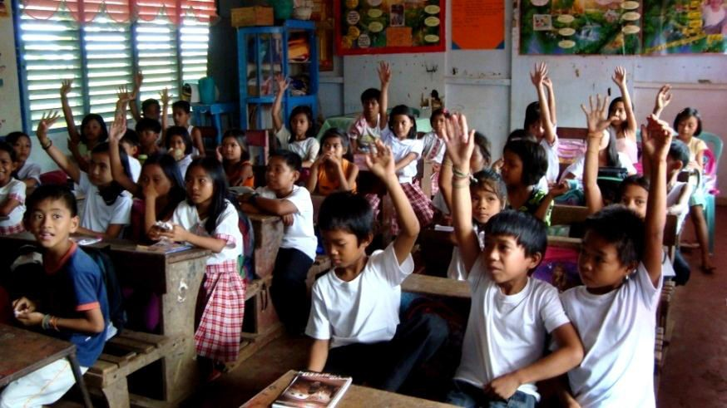



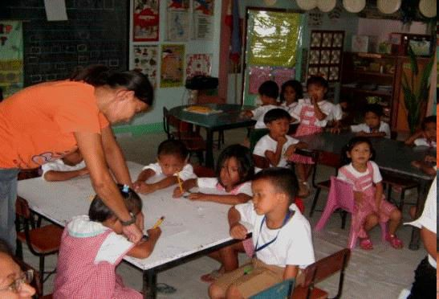

Mga Kondisyon upang makamit ang BENEPISYO
Pumapasok sa Day Care o pre-school at may attendance na di bababa sa 85% kada buwan
Pumapasok sa elementarya o high school at may attendance na di bababa sa 85% kada buwan
Notes:
[READ AND ENSURE UNDERSTANDING] [CAN ASK A PARENT LEADER TO SHARE THIS SLIDE]

Slide 8

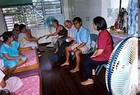



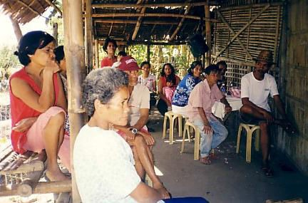



Mga Kondisyon upang makamit ang BENEPISYO
Dumalo sa FDS minsan sa isang buwan
Lumahok sa mga gawaing barangay at palakasin ang pagpapatupad ng Pantawid na programa
Notes:
[READ AND ENSURE UNDERSTANDING] [CAN ASK A PARENT LEADER TO SHARE THIS SLIDE]

Slide 9
i-PANTAWID Objective
To develop a model
for civil society – government partnership
for transparent and accountable
implementation of the
Pantawid Pamilyang Pilipino Program (4Ps)
From the grant agreement – “Capacity building of member organizations of the NLCGG through, inter alia, the carrying out of workshops and training for partner CSOs of the NLCGG to facilitate the adoption of common TPM procedures and tools developed under Part 1, common FDS training curriculum developed under Part 2, and a common menu of social accountability tools for use in the project.”
Notes:
This activity is part of Project i-Pantawid, funded by the Global Partnership for Social Accountability or GPSA, a part of the World Bank. The project proponents are CCAGG, based in Abra, RECITE, based in Pangasinan, and 2 international organizations, PTF and ANSA EAP. You can see their logos at the bottom of this slide. I represent a local civil society organization, [NAME], that is implementing Project i-Pantawid in this LGU. We are a member of the Northern Luzon Coalition for Good Governance or NLCGG.

Slide 10
LGU Selection
Presence of NLCGG partner CSO
Letter of support/MOA from the Mayor
  Provide venue for PL training
  Willing to enter into a Social Contract with Pantawid members
Approved LCSO proposal
Notes:
You may be wondering how your LGU was selected for this project.
The first requirement is that there is a local CSO who would be willing to implement in the LGU. This is our organization, [LCSO NAME].
We then approached your mayor who welcomed the project and entered into a MOA with us [LCSO NAME]. Your mayor provided the venue for the PL training and is willing to enter into a Social Contract with the Pantawid members.
Our organization then prepared a project proposal and budget that was approved by the project management.

Slide 11
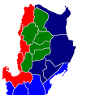
Northern Luzon
Regions I, II, CAR
Solsona, Ilocos Norte
Batch 1 & 2 LGUs
Tineg, Abra
Pilar, Abra
Pidigan, Abra
Rizal, Kalinga
Tayum, Abra
Burgos, Isabela
La Trinidad, Benguet
Rosales, Pangasinan
Urdaneta City
Mapandan, Pangasinan
Notes:
Project i-Pantawid has been implemented in 20 LGUs in Northern Luzon. Based on this good experience, other LGUs may also adopt this model.

Slide 12
What is the enhanced Family Development Session (eFDS)?
LCSO trains Parent Leaders who will train their own beneficiary groups
  Topics on the construction of citizenship and social accountability – common curriculum
  4 hours for Parent Leaders who will conduct regular 2 hours for their beneficiary groups
  Parent Leaders trained by ML group of around 25 PLs, beneficiary groups have 25 – 35 members
Parent Leaders trained in a central location, beneficiary groups trained within the barangay
Mandatory attendance by Grantee, representing the beneficiary family
PL practice social accountability through implementation of TPM tools
Notes:
Under the Pantawid Program of the government, beneficiaries attend a monthly training activity in groups in the barangay. Under Project i-Pantawid, we implemented the enhanced Family Development Session or eFDS. Under the eFDS, [READ and ENSURE UNDERSTANDING].

Slide 13
Multiplier Effect
i-Pantawid Implementing CSO
Parent Leader
Beneficiary Group
Parent Leader
Beneficiary Group
Parent Leader
Parent Leader
Beneficiary Group
Beneficiary Group
100% eFDS conducted monthly for covered LGUs
Notes:
Under the eFDS, our LCSO trains the Parent Leaders on self development and the eFDS topic to be shared with their members, monthly. After this training, the PLs cascade the eFDS topic to their member. Our LCSO works to ensure 100% eFDS conducted monthly for covered LGUs.

Slide 14
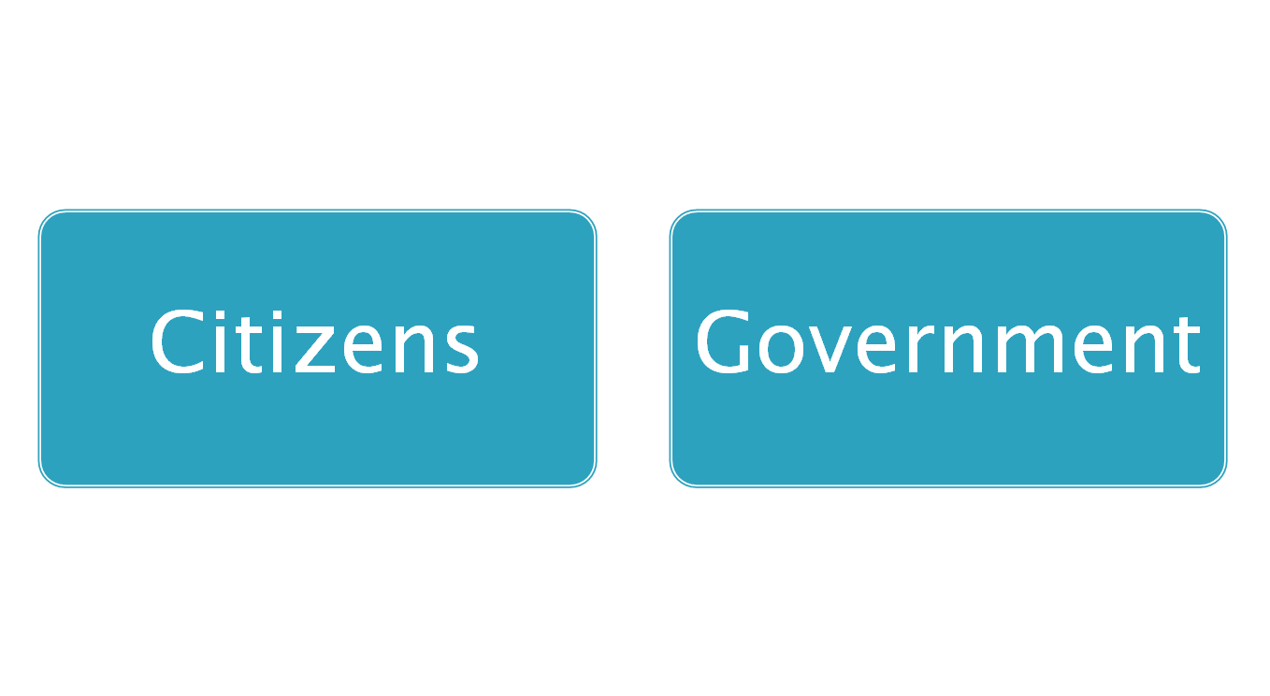
2 Key Players
Constructive Engagement (Makabuluhang Pakikilahok)
For better delivery of
Public service
Improvement of people’s welfare
Protection of people’s rights
= Social Accountability
(Pananagutang Panlipunan)
Notes:
The eFDS modules focus on Social Accountability or Pananagutang Panlipunan.
There are 2 key players that have to work together (pagtutulungan) towards good governance – citizens and government working hand-in-hand. This working together is called constructive engagement (makabulunhang pakikilahok).
The goal of constructive engagement is better delivery of public service, improvement of people’s welfare and protection of people’s rights.
When citizens and government are truly working together, with real citizen participation, they are practising social accountability (pananagutang panlipunan).
14

Slide 15
Community Scorecard (CSC)
A participatory, community-based monitoring and evaluation tool Pamamaraan para makilahok sa pamamahala at pagsusuri
That enables citizens to assess the quality of public services such as a health center, school, public transport, water, waste disposal systems, etc., seeking areas for improvement Pagsusuri ng kalidad ng serbisyo publiko kagaya ng para sa kalusugan, edukasyon, transportasyon, patubig, atbp. para mapabuti o mapaganda ito
Notes:
[READ & ENSURE UNDERSTANDING]

Slide 16
Proseso ng Community Scorecard (CSC)
The CSC informs community members about Paguusapan ang
  available services in the community serbisyo publiko
  their entitlements to these services karapatan natin ukol sa serbisyo publiko
The CSC asks for users’ direct feedback about the quality, efficiency, and accessibility of these services Nagtatanong tungkol sa kalidad, husay at pagkarating ng serbisyo publiko, sa pagbibigay ng “score”
Notes:
[READ & ENSURE UNDERSTANDING]

Slide 17
Proseso ng Community Scorecard (CSC)
Those providing the public service also rate their performance Ang tagapamahala sa serbisyo publiko ay nagbibigay alam din tungkol sa kalidad, husay at pagkarating ng kanilang serbisyo publiko
The service providers and their clients sit down and discuss the scorecard results and how to improve these Ang tagapamahala sa serbisyo publiko at ang tumatanggap ng serbisyo ay nakikipa-ugnayan tungkol sa resulta at paano mapaganda pa ang serbisyo publiko
---Interface Meeting---
Notes:
[READ & ENSURE UNDERSTANDING]
At our meeting today, we will discuss the scorecard results and how to improve these, called an Interface Meeting.

Slide 18
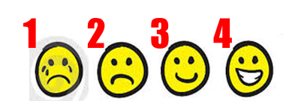
Education Services Community Scorecard
We reviewed the education services provided by DepEd on specific attributes Sinuri natin ang tungkol sa serbisyo edukasyon ng ating bayan
For each attribute, we assigned a score Nagbibigay tugon sa bawat katangian
Indicated reasons for the rating Naglagay ng detalya kung bakit ganun ang ibinigay na puntos at mga mungkahi para mapabuti ang puntos
Notes:
This is what we have done so far. [READ & ENSURE UNDERSTANDING]

Slide 19
Education Services Scorecard
Notes:
This is the education services scorecard we completed, both from the Pantawid members and from the education services providers. The service providers filled up individual forms while the Parent Leaders solicited scores from their members, one for day care, and another one for elementary and high school combined. We have computed for the average score per indicator.

Slide 20
Proseso ng Community Scorecard (CSC)
Supply Side Information
Community Scorecard
Pasya ng Mamamayan
Pasya ng Tagapamahala ng Serbisyo Publico
Interface Meeting/Ugnayan
Action Planning/Pagplano sa Pagbuti ng Serbisyo
Notes:
This is the process we are following. We took supply-side information and made a scorecard. Both citizens and health service providers gave their scores. Today, we are meeting to discuss the scores and to make plans to improve the scores going forward, together.

Slide 21
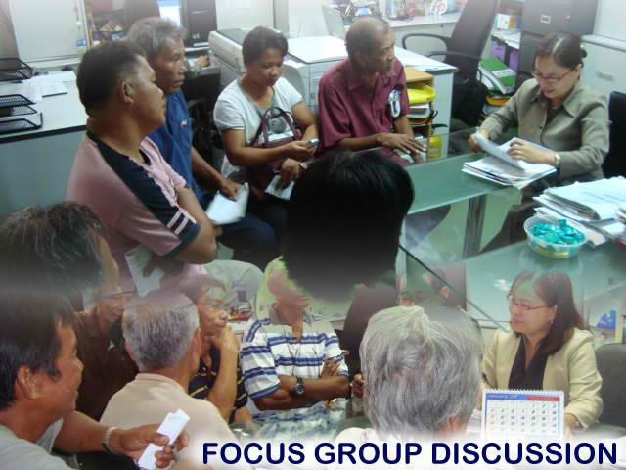
Interface Meeting/Ugnayan
A public forum or meeting where the service providers and users gather to present their respective scorecards and discuss ways to improve service delivery Pagtitipon ng mamamayan at tagapamahala sa serbisyo publiko upang pag-usapan ang mga nabigyang puntos at paano mapabuti ito.
Notes:
We are having an Interface Meeting, where the service providers (education officials/teachers) and users of the service (tayong mamamayan) gather to present their respective scorecards and discuss ways to improve service delivery.

Slide 22
Layunin ng Interface Meeting
To provide a feedback mechanism between the community end-users and government service providers on the quality, efficiency and accountability of the services provided Ugnayan tungkol sa husay ng serbisyo publiko
To agree on recommended solutions, and come up with a plan that will help improve the delivery of services at the local level Magkaisa kung paano mapaganda pa ang serbisyo publiko
Notes:
Magkakaroon ng ugnayan at tapatan tungkol sa husay ng serbisyo publiko sa pagtitipon na ito. Magkakaisa at magtutulungan kung paano mapaganda pa ang serbisyo pang edukasyon.

Slide 23
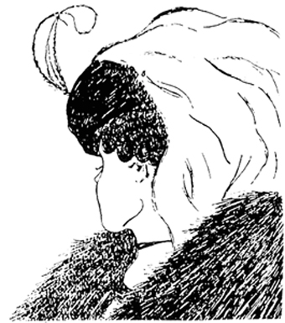
Notes:
Anong nakikita sa litratong ito? Ang iba makakita ng dalaga. Ang iba makakita ng matanda. Sino ang nakakakita ng dalawa? In one picture, we can see different things due to different viewpoints.

Slide 24

Notes:
Here is another example. Nakaharap sa atin o nakaharap sa gawing kanan? Pwedeng magkaibang kuru-kuro sa isang bagay. Tingnan natin ang magkaibang kuru-kuro natin tungkol sa serbisyo publiko ng edukasyon.

Slide 25

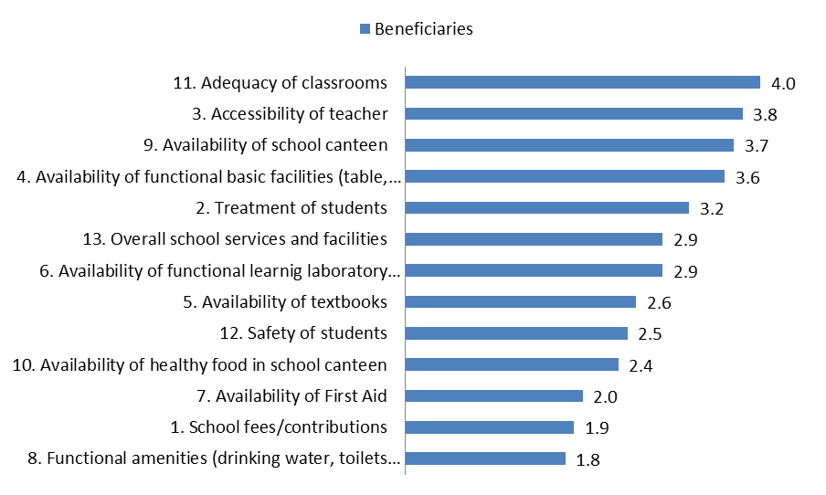
San Nicolas, Ilocos Norte
January, 2017
Respondents – Pantawid Beneficiaries
Elementary and High School
Education Services Delivery Scorecard
1
2
3
4
Sample format, replace with local data
Notes:
[2 sets of slides will be prepared, one for day care and another for the elementary and high school combined. The sample given is one set for elementary and high school. Another set will have to be prepared for day care scores. Chart formatting is best using excel.
This chart contains the average score per indicator gathered from the beneficiaries, sorted from highest to lowest score. The green line is drawn in, highlighting indicator scores 3.0 and above.
Present the scores from highest to lowest. Affirm the service provider for the higher scores. The lower scores are opportunities for improvement. We have to be careful in the presentation throughout. We don’t wish the service provider to become defensive but to remain open to the opportunities for improvement.]

Slide 26
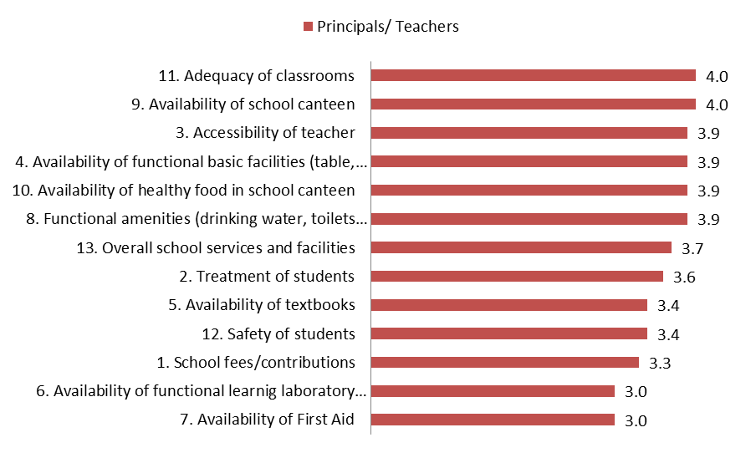
San Nicolas, Ilocos Norte
January,2017
Respondents – Education Services Provider
Elementary and High School
Education Services Delivery Scorecard
1
2
3
4
Sample format, replace with local data
Notes:
This chart contains the average score per indicator gathered from the service provider, sorted from highest to lowest score. The green line is drawn in, highlighting indicator scores 3.0 and above.
Present the scores from highest to lowest. Affirm the service provider for the higher scores. The lower scores are opportunities for improvement. We have to be careful in the presentation throughout. We don’t wish the service provider to become defensive but to remain open to the opportunities for improvement.]

Slide 27
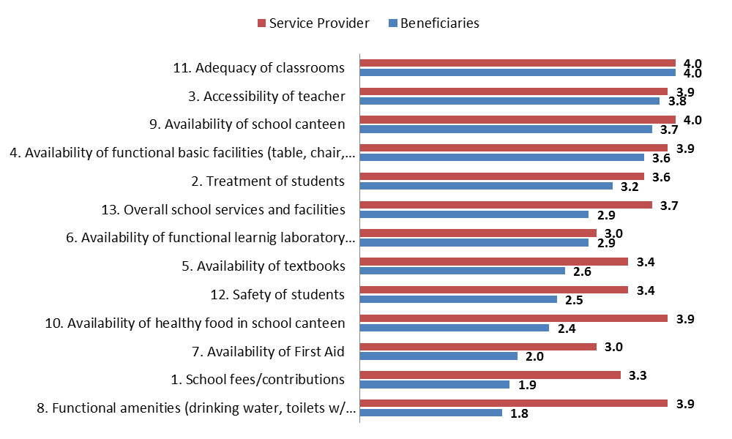
San Nicolas, Ilocos Norte
January, 2017
Beneficiaries and Service Provider
Elementary and High School
Education Services Delivery Scorecard
1
2
3
4
Sample format, replace with local data
Notes:
This chart contains the average score per indicator gathered from both the service provider and Pantawid beneficiaries, sorted from highest to lowest score of the beneficiaries. The green line is drawn in, highlighting indicator scores from the beneficiaries of 3.0 and above.
Point out indicators with similar scores from both the beneficiaries and service provider, then go through indicators with very different scores. Affirm the service provider for the higher scores. The lower scores are opportunities for improvement. We have to be careful in the presentation throughout. We don’t wish the service provider to become defensive but to remain open to the opportunities for improvement.]

Slide 28
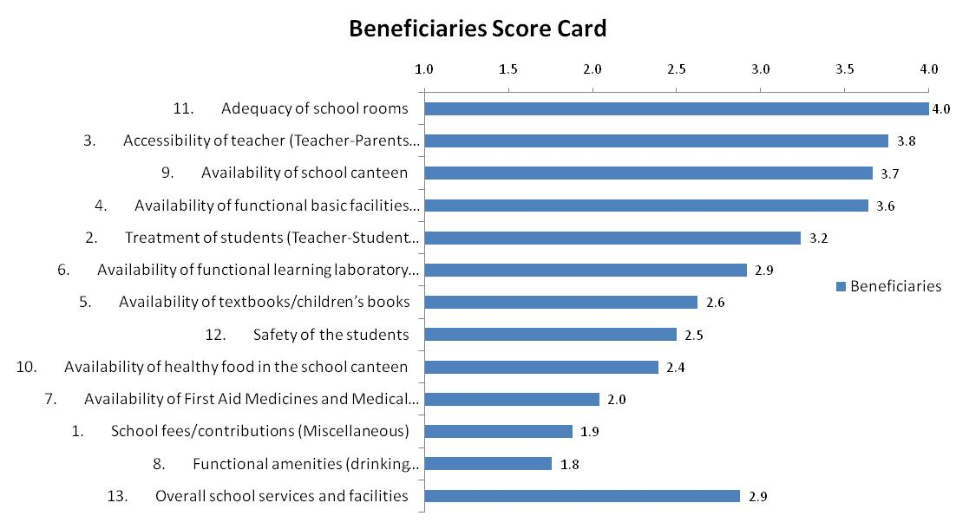
Reasons for Rating and Suggestions for Improvement
Adequacy of school rooms
-sufficient rooms for every grade/section
Maintain
Sample format, replace with local data
Accessibility of teacher (Teacher-Parents relationship)
-good relationship
Maintain
Notes:
[The following charts contain the reasons for rating (black) and suggestions for improvement (red) from the beneficiaries, for each indicator. The scores for the indicators in the slide are given below the chart title as a reference during the discussion. For satisfactory scores, such as the chart above, the suggestion for improvement could simply be to maintain the current state. There may be 2 to 3 indicators per slide. The objective of the slide content is to trigger a discussion between the beneficiaries and service provider. The objective of the discussion is to arrive at specific action plans towards service improvement.
For each indicator, share the beneficiary score, then move to the reasons for rating and suggestions for improvement given. Solicit other suggestions for improvement per indicator. Any agreed action steps are to be written on a manila paper that everyone can view, following the Action Plan template in this deck.
When there are time constraints, the facilitator may opt to start the discussion from the indicators with the lowest beneficiary score, moving up towards the higher scores.

Slide 29
Reasons for Rating and Suggestions for Improvement
Availability of school canteen
-May school canteen
Maintain
Sample format, replace with local data
Availability of functional basic facilities( table, chair, electric fans)
- Complete basic equipments
-Maintain
-More basic facilities
Notes:
For each indicator, share the beneficiary score, then move to the reasons for rating and suggestions for improvement given. Solicit other suggestions for improvement per indicator. Any agreed action steps are to be written on a manila paper that everyone can view, following the Action Plan template in this deck.

Slide 30
Reasons for Rating and Suggestions for Improvement
Treatment of students( Teacher-Student relationship)
-Very good
-Nice, Caring/Approachable
-Maintain
-Dapat pantay-pantay ang trato sa mga bata
Sample format, replace with local data
Availability of functional learning laboratory facilities
-Some schools lack of learning facilities esp. computers
-May computers sa ibang schools pero may bayad
-Dapat dagdagan at ipagamit sa
mga bata
- Ipagamit ng libre
Notes:
For each indicator, share the beneficiary score, then move to the reasons for rating and suggestions for improvement given. Solicit other suggestions for improvement per indicator. Any agreed action steps are to be written on a manila paper that everyone can view, following the Action Plan template in this deck.

Slide 31
Reasons for Rating and Suggestions for Improvement
Availability of textbooks/ children’s books
-Not complete
-Sana kumpleto ang maibigay
-Dapat lahat ng estudyante mabigyan at pwedeng iuwi
Sample format, replace with local data
Safety of the students
-Some schools do not have security guard and security fences
- May security fences pero mababa
-Dapat may guard at mas mataas sana ang bakod
Notes:
For each indicator, share the beneficiary score, then move to the reasons for rating and suggestions for improvement given. Solicit other suggestions for improvement per indicator. Any agreed action steps are to be written on a manila paper that everyone can view, following the Action Plan template in this deck.

Slide 32
Reasons for Rating and Suggestions for Improvement
Availability of healthy food in the school canteen
-Junk foods and softdrinks still available in the school canteen
-Sana wala ng softdrinks at
junk foods sa mga canteen
Sample format, replace with local data
Availability of First Aid Medicines and Medical Personnel
-Some schools do not have medical personnel
-Magkaroon din sana ng medical
personnel sa mga schools na wala
Notes:
For each indicator, share the beneficiary score, then move to the reasons for rating and suggestions for improvement given. Solicit other suggestions for improvement per indicator. Any agreed action steps are to be written on a manila paper that everyone can view, following the Action Plan template in this deck.

Slide 33
Reasons for Rating and Suggestions for Improvement
School fees/ contributions (Miscellaneous)
-A lot of school fees/contributions to pay
-Maminimize sana ang mga babayaran
Sample format, replace with local data
Functional amenities (drinking water, toilets, water for toilets, electricity)
-Students pay for their drinking water
-Mahal masyado
Notes:
For each indicator, share the beneficiary score, then move to the reasons for rating and suggestions for improvement given. Solicit other suggestions for improvement per indicator. Any agreed action steps are to be written on a manila paper that everyone can view, following the Action Plan template in this deck.

Slide 34
Reasons for Rating and Suggestions for Improvement
Overall school services and facilities
-Some schools still lack services and facilities
-Needs more improvement
-Sana baguhin ang sistema
- Improve
Sample format, replace with local data
Notes:
For each indicator, share the beneficiary score, then move to the reasons for rating and suggestions for improvement given. Solicit other suggestions for improvement per indicator. Any agreed action steps are to be written on a manila paper that everyone can view, following the Action Plan template in this deck.

Slide 35
INTERFACE MEETING ACTION PLAN – Education LGU_____________________________ Date ________________
 | Indicator | Action to be Taken | By Whom | When
1 | Availability of textbooks | The available textbooks are photocopied by the teachers | Teachers
2 | Availability of healthy foods in the school canteen | District Supervisor will call up all school heads to remind to them that there will be no more junk foods in the school canteens | District Supervisor | The soonest possible time
3 | School Fees | Teachers agreed to give a temporary receipts to benes whose going to pay for school fees and contributions | Teachers and Parents | The soonest possible time
4 | Treatment of Students | ML, DS, PLs agreed to have a quarterly meeting/ report about issues and concerns of the school | ML, DS, PLs | Next quarter
Sample format, replace with local data
Notes:
[This is the Action Plan Template. During the Interface Meeting, the action plans contributed and agreed upon by the group are written on manila paper for all to see. After the Interface Meeting, transfer the action plans from manila paper to this template for documentation purposes. There will be two Action Plans prepared, one for day care and another for elementary and high school combined. Action Plans may need more than one slide.]

Slide 36
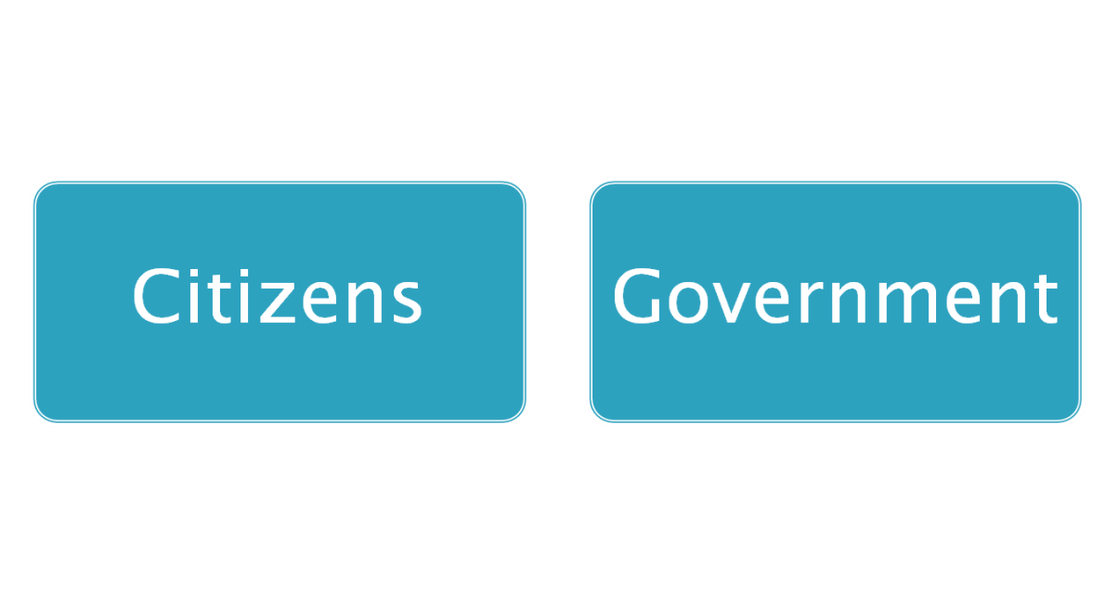

Coming together is a beginning,
staying together is progress, and
working together is success.
-- Henry Ford
Ang pagsasama-sama ay pang-umpisa,
Ang manatiling magkasama ay progreso,
Ang magkasamang magtrabaho ay tagumpay.
Notes:
Ang pagsasama-sama ay pang-umpisa, ang manatiling magkasama ay progreso, ang magkasamang magtrabaho ay tagumpay.
Manatili tayong magkasama, mamamayan at tagapamahala ng serbisyo publiko, para makamtan ang tagumpay!

Slide 37
Maraming salamat po!

