Slide 1
Welcome
TUNGO SA
BAYANG MAGILIW - 1
Ang Tulong ng Pantawid
Notes:
[GREETING, INTRODUCE SELF AS FACILITATOR] This is the first eFDS topic that you will share with your members. It’s all about the Pantawid Pamilyang Pilipino Program, so you should know the contents very well.

Slide 2
eFDS1 - Ang Tulong ng Pantawid
Pantawid Program (4Ps)
Beneficiary Update System
Compliance Verification System
Grievance Redress System (GRS)
Notes:
We will run through these 4 main topics – [READ]

Slide 3
Notes:
The Pantawid Pamilyang Pilipino Program, or Pantawid Program, is a program of the government through the Department of Social Welfare and Development, in which you are enrolled as a member.
i-Pantawid, on the other hand, is a private sector project. You may recall we discussed this at the Foundation Session. [EMPHASIZE DIFFERENCE]

Slide 4
●
Ito ay isang puhunang pantao para sa mga bata sa pamamagitan ng pangangalaga ng kalusugan at edukasyon
●
Nagbibigay ng tulong sa mga mahihirap na pamilya na may mga anak edad 0-18 yrs. old kasama ng kanilang mga ina
●
Putulin ang manang kahirapan sa pamamagitan ng pagpapalago sa pantaong kayamanan, gaya ng edukasyon, kalusugan at nutrisyon
Notes:
[READ & DISCUSS]

Slide 5
Mga Kondisyon upang makamit ang BENEPISYO
Pumunta sa lokal na health center para sa check-up bago at pagkatapos manganak
Magkaroon ng kahit isang check-up anim na linggo pagkatapos manganak
Notes:
[YOU CAN ASK THE PARTICIPANTS TO GIVE THE CONDITIONALITIES, ENSURING COMPLETENESS]

Slide 6
Mga Kondisyon upang makamit ang BENEPISYO
Children 0-5 Years Old
Visit the health center to avail immunization Pagbabakuna
Have monthly weight monitoring and nutrition counseling for children aged 0 - 2 years old Magtimbang minsan kada buwan
Have bi-monthly weight monitoring for 2 – 5 years old Magtimbang minsan kada 2 buwan
Have management of childhood diseases for sick children Mabigyang lunas ang batang may sakit
Children 6-18 Years Old
Must receive deworming pills twice a year (through school) Magpurga sa paaralan
Notes:
[YOU CAN ASK THE PARTICIPANTS TO GIVE THE CONDITIONALITIES, ENSURING COMPLETENESS]

Slide 7
Mga Kondisyon upang makamit ang BENEPISYO
Pumapasok sa Day Care o pre-school at may attendance na di bababa sa 85% kada buwan
Pumapasok sa elementarya o high school at may attendance na di bababa sa 85% kada buwan
Notes:
[YOU CAN ASK THE PARTICIPANTS TO GIVE THE CONDITIONALITIES, ENSURING COMPLETENESS]

Slide 8
Mga Kondisyon upang makamit ang BENEPISYO
Dumalo sa FDS minsan sa isang buwan
Lumahok sa mga gawaing barangay at palakasin ang pagpapatupad ng Pantawid na programa

Slide 9
Mga benepisyo kapag natupad ang mga kondisyon
+ Rice subsidy (2017)
Notes:
[QUIZ THE PARTICIPANTS ON THE AMOUNTS BEFORE SHOWING SLIDE]
A new benefit starting this 2017 is the rice subsidy of P600 per month.

Slide 10
2008
2012
2014
2009
2011
2013
Notes:
Do you know how many Pantawid members there are nationwide? The Pantawid Program started in 2007 with 4,500 members, growing to 300,000 in 2008, then 700,000 in 2009. By 2010, there were 1 million members, and it grew yearly, so that by 2014, there were 4.1 million members, and that number is maintained up to now. With 4.1 million member families, the total number of beneficiaries of the Pantawid Program is around 20 million Filipinos.

Slide 11
FDS GUIDELINES
Notes:
The DSWD has set certain guidelines for the conduct of the FDS, now eFDS with i-Pantawid. You are now facilitators of the eFDS, so you have to be familiar with these guidelines.

Slide 12
Participants – Mga Kalahok
Head grantee (usually the mother)
Spouses are ENCOURAGED Hinihikayat ang asawa
Parent Group = 25-35 members
Selection of Parent Leader per group
Notes:
[READ AND DISCUSS] How was your Parent Leader selected?

Slide 13
Schedule
Venue
Once a month
Agreed by parents
Scheduled quarterly
Accessible Madaling marating
Safe Ligtas na lugar
Program Flow
A. Preliminaries
Attendance Check
Opening amenities
B. FDS Proper
Actual topic
C. Other concerns
Updates
Grievances
Program updates
Review of Talaarawan ng Sambahayan
Notes:
[READ AND DISCUSS]

Slide 14
Absences
Sick/health condition May sakit o karamdaman
Person observing IP practices/rituals May mga gawain na tumutupad ang tribu/grupong katutubo
Proxy attendance
Any adult member of the household Sino mang nasa edad na miyembro ng pamilya
Once a semester only Minsan kada 6 buwan lamang
Notes:
[READ AND DISCUSS]

Slide 15
Remedial FDS
Valid reason for being absent May tanggap na dahilan ng pagliban
Within the month Sa parehong buwan ng pagliban
Same topic Parehong paksa
No transportation cost Walang gastusin na pamasahe
Once a semester Minsan lang kada 6 buwan
Tardiness
30 minutes = Late
3 lates in 6 months = Absent
Notes:
[READ AND DISCUSS]

Slide 16
Postponement
Kailan lang pwedeng maipagliban ang FDS?
Disruption of local peace and security Kaguluhan
Disaster (threat to life) Sakuna, panganib
Notes:
[READ AND DISCUSS]

Slide 17
No Clustering of Session
No clustering Hindi pwedeng ipagsama sa FDS ang iba-ibang grupo
Use of Talaarawan
Documentation of activities Dokumentasyon ng mga gawain
Monitored every FDS Tinitingnan kada FDS
Notes:
[READ AND DISCUSS, CHECK THAT THESE GUIDELINES ARE BEING FOLLOWED]

Slide 18
Code of Conduct for Facilitators
No gift policy Walang magbibigay o tatanggap ng regalo
No collection of money or kind Walang hihingi/mangongolekta ng pera
No selling of merchandise by training team Walang miyembro ng training team na magtitinda ng anumang bilihin
No activities compromising the integrity of the staff or the program Walang gawaing makasisira sa integradad ng mga staff o sa programang Pantawid
Notes:
[READ AND DISCUSS, CHECK THAT THESE GUIDELINES WILL BE FOLLOWED]

Slide 19
Beneficiary Update System (BUS)
Objectives - Hangarin
To facilitate the correction/updating of the registered beneficiaries’ data/information Upang mapabilis ang pagtama o pagbago sa mga impormasyon tungkol sa mga kasapi ng pamilya sa Pantawid
Determines the entitlement of cash assistance the households should receive from the program Upang malaman ang tamang cash assistance na matatanggap ng pamilyang kasapi sa Pantawid
Notes:
We will now discuss the Beneficiary Update System or BUS. [READ AND DISCUSS]

Slide 20
Types of Update – Uri ng Pagbabago
Newborn
Change of Address
Moving Out of the city/municipality/barangay outside 4P's Area (Not applicable)
New/Change of Servicing Health Unit
Change of School/New Enrollment
Change of Beneficiary/Mother Grantee
Death (deceased household member)
Biological or legally adopted child (0-14) coming back home
Correction of Basic Information (name, sex, birthday, relationship to household head, Person/Children with Disability
IP affiliations
Replacement of Child/ren for CVS Education Monitoring (for set 6 and set 7 only)
USING BENEFICIARY UPDATE (BU) FORM 5
Notes:
[READ AND DISCUSS] Among these items, one very important update that affects the amount you receive is item no. 5 – Change of school/new enrolment. Why is this important? What happens when your child graduates from elementary, for example. What is your experience? If the data about the new school (high school) is not updated on time, you can experience a delay in the amount of pay out for that child. It’s very important to ensure that the information about you and your family is up to date.

Slide 21
Compliance Verification System (CVS)
A system that monitors how faithfully the beneficiaries comply with the conditions set by the Pantawid Pamilya Program Sistema na tumitingin kung ang mga pamilyang miyembro ng Pantawid ay sumusunod sa mga nakatatakdang kondisyones ng programa
Notes:
Next we have the Compliance Verification System or CVS.

Slide 22
CVS Form 2 Education
CVS Form 3 Health
CVS Form 4 FDS
ENCODER
REGIONAL FOCAL PERSON
REGIONAL DIRECTOR
PAYROLL
(End)
NATIONAL PROGRAM MANAGER
NPMO CVS FOCAL PERSON
CVS Encoding and Approval Flow
Notes:
This is the process by which your compliance is verified. CVS Form 2, for education, is completed by someone in your childrens’ school and signed by the Principal. CVS Form 3, for health, is completed by the midwives who man the Barangay Health Stations and signed by the Municipal Health Officer. CVS Form 4, for FDS attendance, is prepared by the City/Municipal Link based on the attendance form.
All the information received by a specified cut-off date is submitted to the DSWD Regional Office where it is encoded into a computer. Then we have the various verifications and approval of the information, from the Regional Focal Person for the Pantawid Program, to the Regional Director, then to the National Program Management Office (NPMO) CVS Focal Person, then to the National Program Manager. After all verifications and approvals, the payroll is computed.

Slide 23
2015 Pay-out Schedule
Payout - 5 weeks after covered period
Payment No. | Months Covered | Payroll Done
1 | Feb – Mar | Apr
2 | Apr – May | Jun
3 | Jun – Jul | Aug
4 | Aug – Sep | Oct
5 | Oct – Nov | Dec
6 | Dec - Jan | Feb
May
Jul
Sep
Nov
Jan
Mar
Notes:
This is the Pay-out schedule. [CHECK IF BEING FOLLOWED]

Slide 24
CV Forms
Monitoring tools used in measuring compliance of the beneficiaries with the conditions of the program
Are generated at the National Project Management Office (NPMO) based on the database of beneficiaries and their historical compliance data
Notes:
We have talked a bit about the CV Forms. We will now look at these forms in more detail. [READ AND DISCUSS]

Slide 25
CV Form 1 - Masterlist
Provides the general information on the beneficiaries that are sufficient for the user to infer on the identification of the beneficiary Dito nakapaloob ang pangalan at mga iba’t-ibang impormasyon na pagkakakilanlan ng bawat kasapi sa Programa
Printed on a per-barangay basis and are distributed to the concerned City / Municipal Link by the Field Office Ito ay naitatala sa kada barangay na nasa pagiingat ng City o Municipal Link
Notes:
[READ AND DISCUSS]

Slide 26
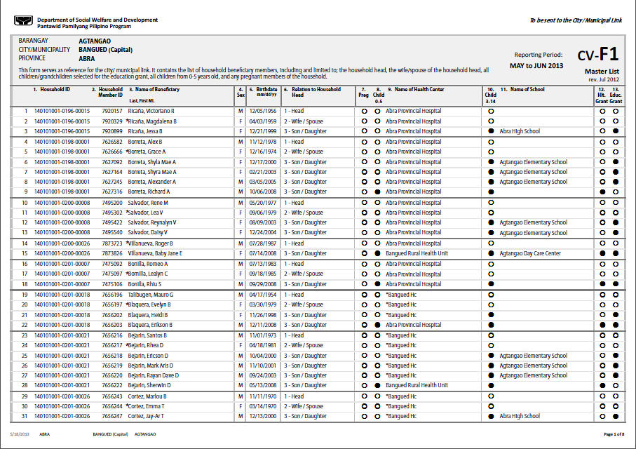
CV FORM 1
Masterlist
Notes:
This is what CV Form 1, or Masterlist, looks like. All the information about you, needed by the Pantawid Program, is listed here.

Slide 27
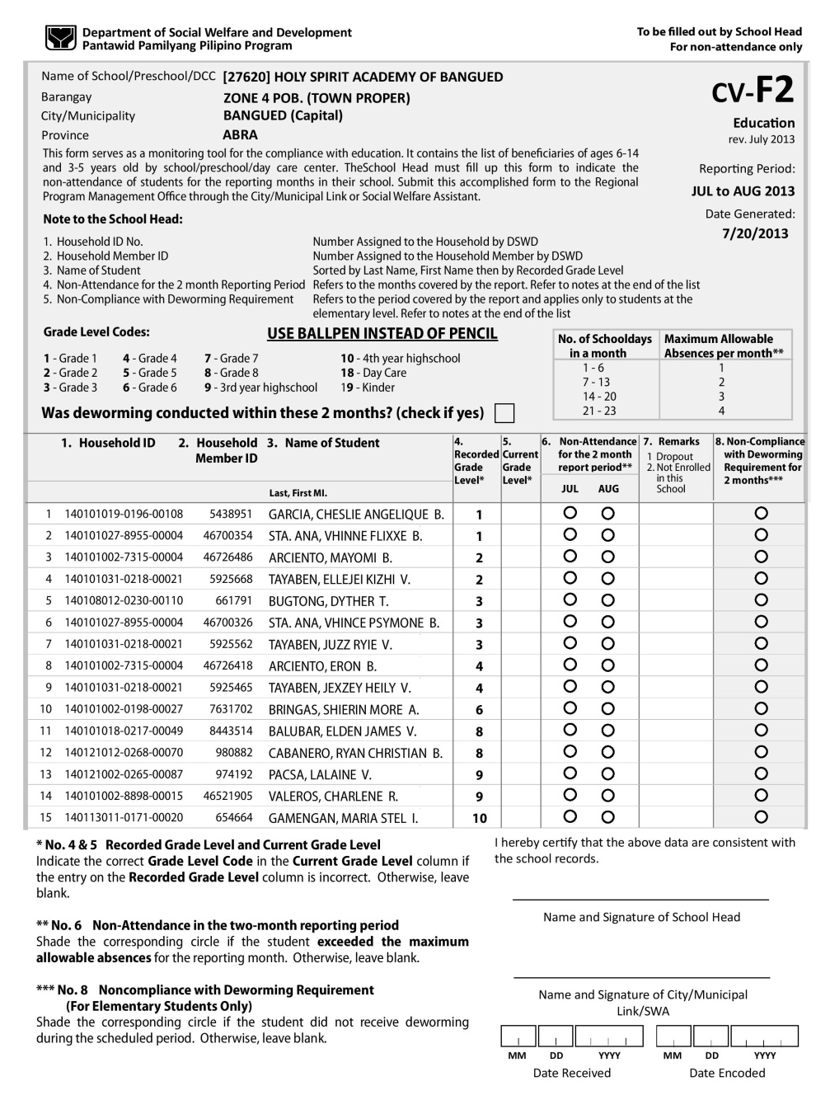
CV FORM 2
Education
Monitoring tool on the compliance of the beneficiaries with regard to education Impormasyon kung sino ang sumusunod sa kondisyon ng edukasyon
Pre-printed list of beneficiaries with ages 3-18 years old by (school / preschool / daycare center) education facility Listahan ng lahat ng mga miembrong bata
c/o Principal / Teacher-in-charge of day care center / Preschool School Head based on the reports submitted by the teachers
Notes:
CV Form 2 covers education. This form is prepared by someone in your childrens’ schools, based on attendance records. [READ AND DISCUSS]

Slide 28
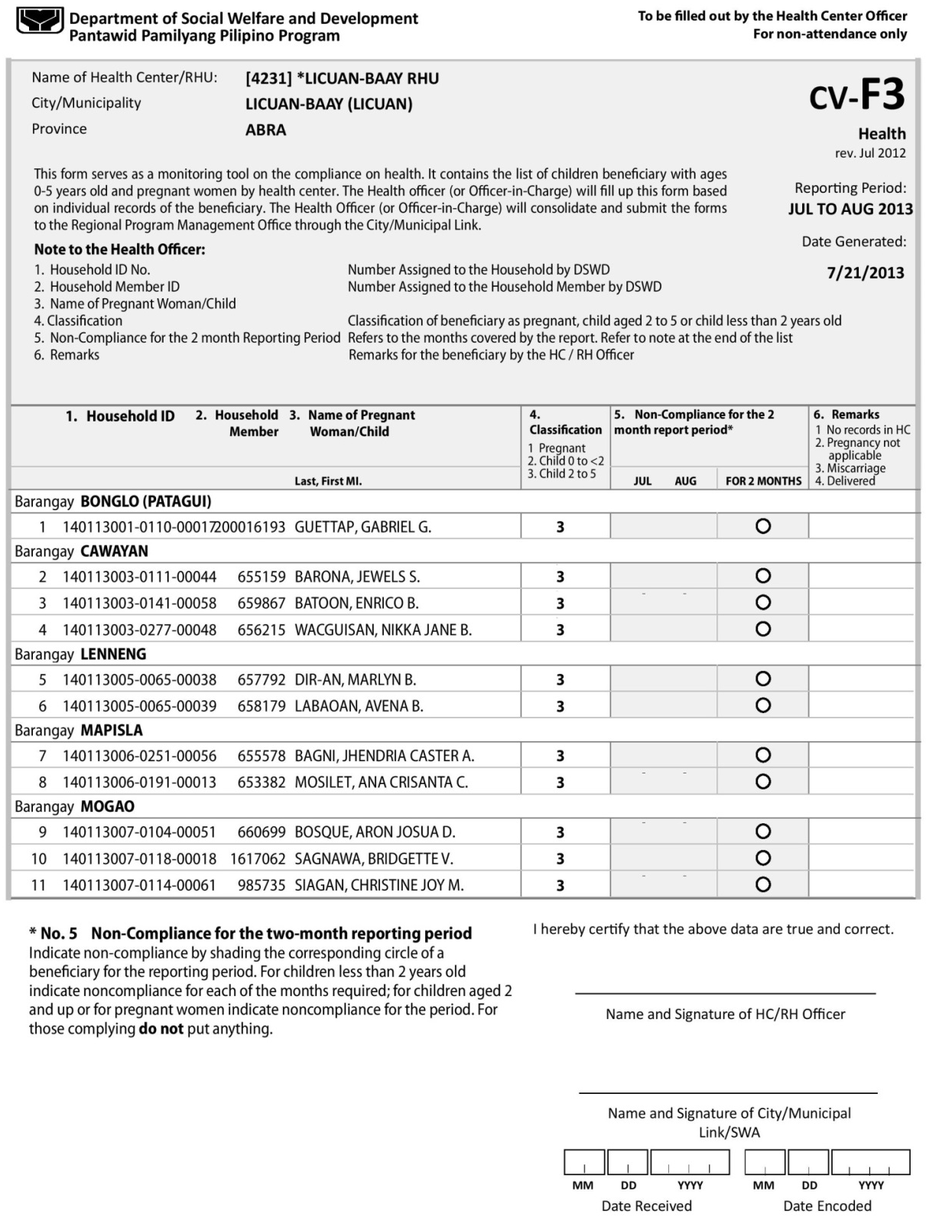
CV FORM 3
Health
Monitoring tool on the compliance with health Upang malaman sino sa mga miembro ang tumutupad sa kondisyong kalusugan
Contains the list of children beneficiary with ages 0-5 years old and pregnant women by health facility Listahan ito ng mga batang kasapi na may edad mula 0-5 years old at mga buntis na dapat dumalo sa bawat health facility
c/o Municipal Health Officer/Midwife
Notes:
CV Form 3 covers your health benefit. This is filled up by the Midwives, based on the BHS logbook, and signed by the City/Municipal Health Officer. So it’s very important that when you visit the BHS, your visit is recorded in the BHS logbook. [READ AND DISCUSS]

Slide 29
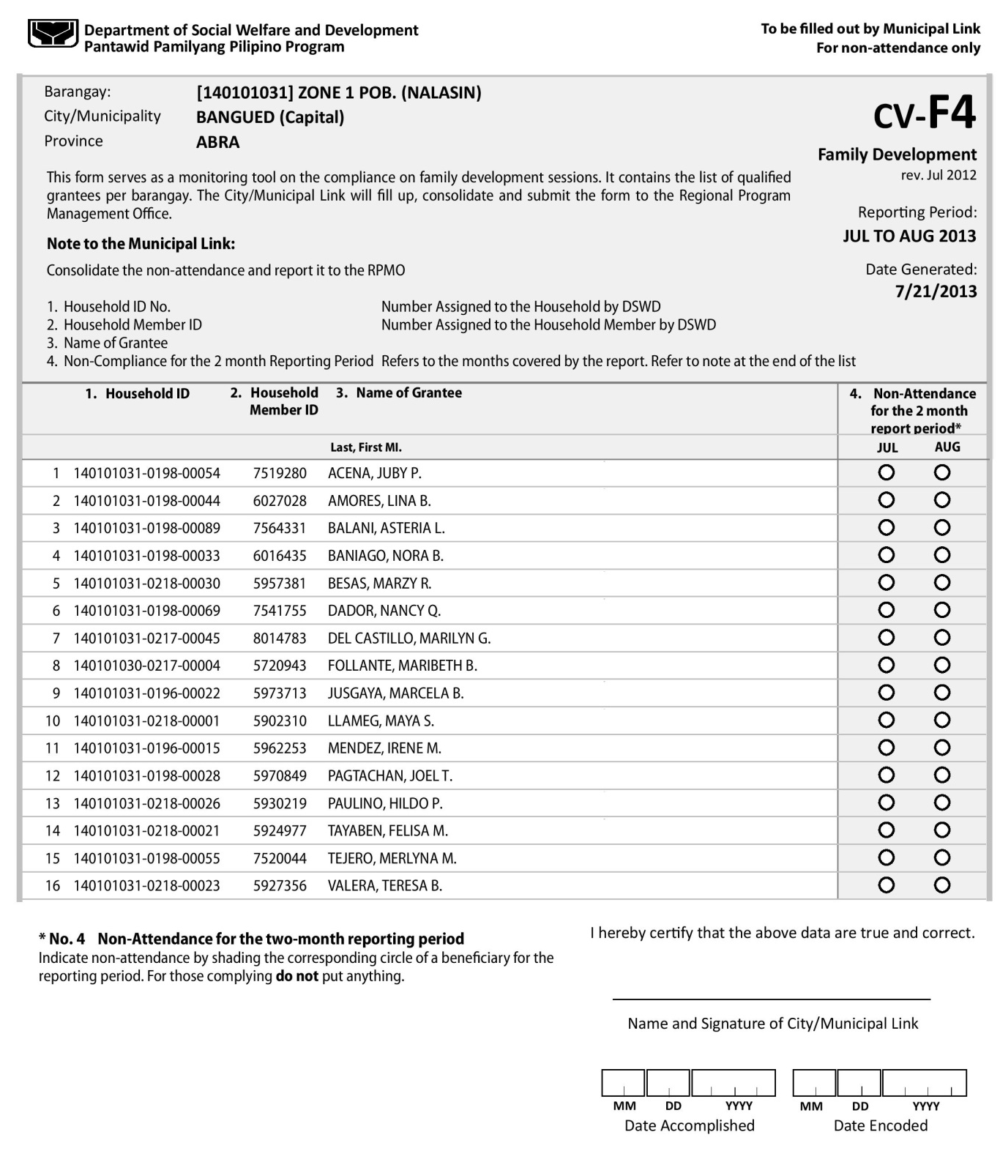
CV FORM 4
FDS
Provides verification on the attendance of qualified grantees to family development sessions Nagbibigay impormasyon tungkol sa pagdalo ng grantee sa FDS
Contains the list of qualified grantees per barangay Ito ay listahan ng mga miyembro ng programa kada barangay
Based on FDS Attendance Sheet
c/o City/Municipal Link and PL
Notes:
CV Form 4 contains your attendance to the monthly FDS, based on the FDS attendance sheet. This form is prepared by the City/Municipal Link(s).

Slide 30
Summary of Conditionalities
Education
Min. 85% attendance
Deworming (Elementary/High School) 2 x a year
Health
Pregnant household member – Pre and post natal check ups, use of birthing center
0 – 2 years – Monthly check up
2 – 5 years – Bi-monthly check up
Immunization
FDS attendance monthly
Notes:
[QUIZ THE PARTICIPANTS ON THE SUMMARY OF CONDITIONALITIES]

Slide 31
Self-Monitoring Forms (BM3)
Education
On Self-monitoring form
Write child name and school, month 1 and month 2
Shade Saturdays, Sundays and Holidays (no class)
Log daily child attendance on class days
At end of the month, count total class days and total attendance days, compute %
Transfer attendance to Self-monitoring form
Health
For every visit to Health Center
For children
Log name of child, age, date, weight, get signature of health worker
Write name of child, age, date of check-up, weight
For pregnant mother
Log date of visit
Write weight
FDS – Log date, topic, facilitator
Notes:
Now you know how the DSWD monitors your compliance. Are you sure that the monitoring is correct? How can you make sure that it’s correct? [SOLICIT IDEAS] You can only be sure that the DSWD monitoring is correct if you monitor your own compliance.
How can we do this? You have to make sure about your child’s attendance. When he goes out the door in the morning, how sure are you that he did attend school? Do you write down when he attends? Do you write down when he’s absent?
For health, do you write down when you visit the health center?
For FDS, do you document every FDS in your Tala-arawan?
Only if you do self-monitoring can you be sure that the amount you receive every 2 months is correct.
[IF FORM BM3 IS TO BE PROVIDED, DISTRIBUTE AND TEACH THE PARTICIPANTS HOW TO FILL THIS UP. IF NO FORM BM3 IS TO BE PROVIDED, ENCOURAGE THE PARTICIPANTS TO LOG THEIR COMPLIANCE ON THEIR TALA-ARAWAN.]

Slide 32
Grievance Redress System (GRS)
Submission, reporting or indirect capture of grievances through various means established under grs
Grievances must be recorded on the complaints form, entered into the MIS, assign tracking number and distribute to the appropriate level
The relevant individual or body shall investigate & verify the facts of the complaint
Resolution of grievance based on existing guidelines
Ensure that the complainant and relevant stakeholders are informed of the outcome of their complaint
Appeal is available if client is not satisfied decision of the NGC is final and executory
Dissemination of the outcome of complaint to relevant stakeholders
Submission/ Receipt of Grievance
Recording
Fact-Finding
Resolution
Initial Feedback
Appeal
Final Feedback
Mayroon ba kayong gustong iparating sa mga namamahala sa Pantawid Program?
Notes:
We will now talk about the Grievance Redress System or GRS. Mayroon ba kayong gustong iparating sa mga namamahala sa Pantawid Program? If you have any concerns or suggestions for the Pantawid Program management, you can submit this through the GRS.
The GRS is a formal system that goes through several steps. [READ STEPS]

Slide 33
Submission/Receipt of a Grievance
A complaint is filed through any of the established GRS channels:
Grievance Form accomplished during a visit to the Pantawid Pamilya office, or contacts with field workers,
Text message via the Pantawid Text Hotline (PTH)
0918-9122-813
4ps<space>pangalan<slash>lugar<slash>reklamo
Hal. 4ps Juan Cruz/Barangay 101,Quezon City/Wala ako sa payroll
Email - 4psreklamo@gmail.com
Facebook - Tanggapan ng Reklamo
Twitter - @4psreklamo
Pwede mag-sumite ng GRS Form pag nagkaroon ng FDS
Notes:
You can submit a concern or suggestion for improvement in several ways. [READ AND DISCUSS] You can also submit a concern or suggestion for improvement to the facilitator of the FDS.

Slide 34
GRS Form
Notes:
There is a GRS Form, just to ensure that all the information you are giving to resolve your concern or suggestion is complete. This form is available at the city/municipal Pantawid office. Again, even if you don’t have this form, it shouldn’t stop you from submitting a concern or suggestion. And if you do submit a concern or suggestion, make a copy in your Tala-arawan, and follow-up progress from time to time.

Slide 35
Notes:
One of the main goals of Pantawid is to ensure your children have the opportunity to go to school. This is one child of a Pantawid member who graduated high school as valedictorian. Congratulations, Christine Mae! And congratulations to all your children who are enabled to stay in school and complete at least secondary education.

