Slide 1
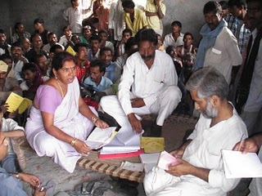
Rise of the Audit Society
Some Cautionary Tales

Slide 2
The Challenges
Technique over Politics – mastering the methods, but forgetting the fundamentals
Tyranny of ‘tools’- empirics to sustainability
Credibility of Champions – whose demand? whose voice?
Perils of constructive engagement – power asymmetries and cooption
Assessing impact & presenting evidences– do snapshots tell us everything?

Slide 3
Five Themes to focus…

Slide 4
1. Building Political Intelligence & Incentives
Context matters for outcomes – knowledge gap on practices
Changing political brakes to accelerators – role of communication

Slide 5
2. Choosing the Tool
Tools driving the agenda
Need for protocols and standards – the case of ‘Social Audits’
Embedding capacities for iterative actions

Slide 6
3. Consequences of Mobilization
Romance of ‘Rude Accountability’
From Civil to Political Society– Rise of new patrons

Slide 7
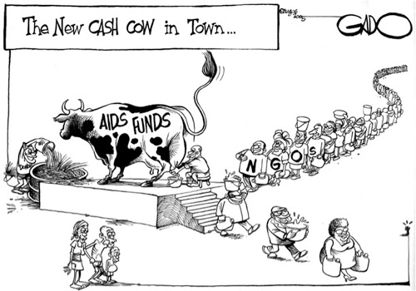
4. Demand Side Accountability
Social Movements Vs Civil Society – question of genuine demand
Increasing Deficit of Trust
Social outcomes over organizational sustainability
Reviewing impact assessments – moving beyond snapshots

Slide 8
5. Strategizing Actions
Positioning the intervention – Efficiency Vs Accountability
Sequencing public dissemination – Presenting the complete story
Balancing collaboration/contestation

